Slide 1
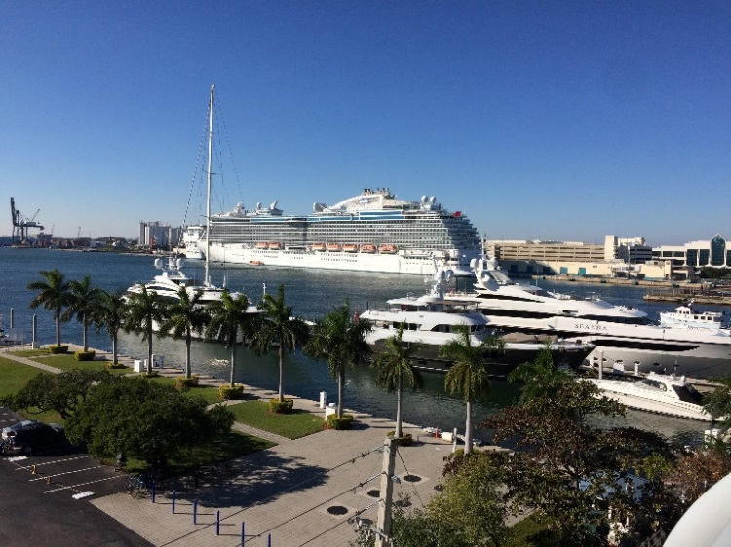



Hear the World:
Traveling With Today’s Hearing Technology
Scott Murray
Chicago, Illinois
©Copyright 2019 Scott Murray

Slide 2
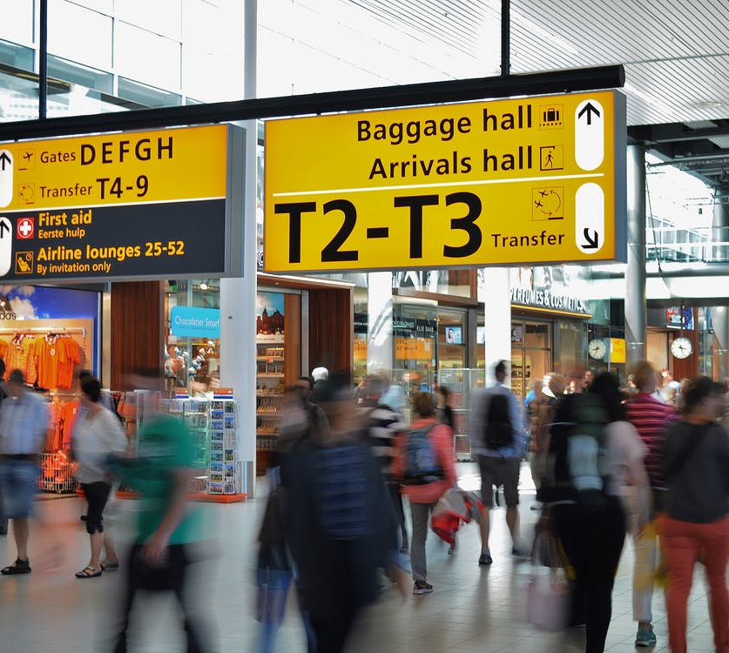
At the Airport
Security screening is no problem
  Processors/accessories can go through all scanners
  Unlikely to trigger alarms
  Bring your patient ID card
Keep all CI related items in your carry-on!
Processors do not need to be turned off during take-off

Slide 3
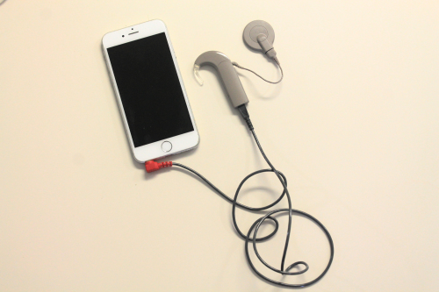
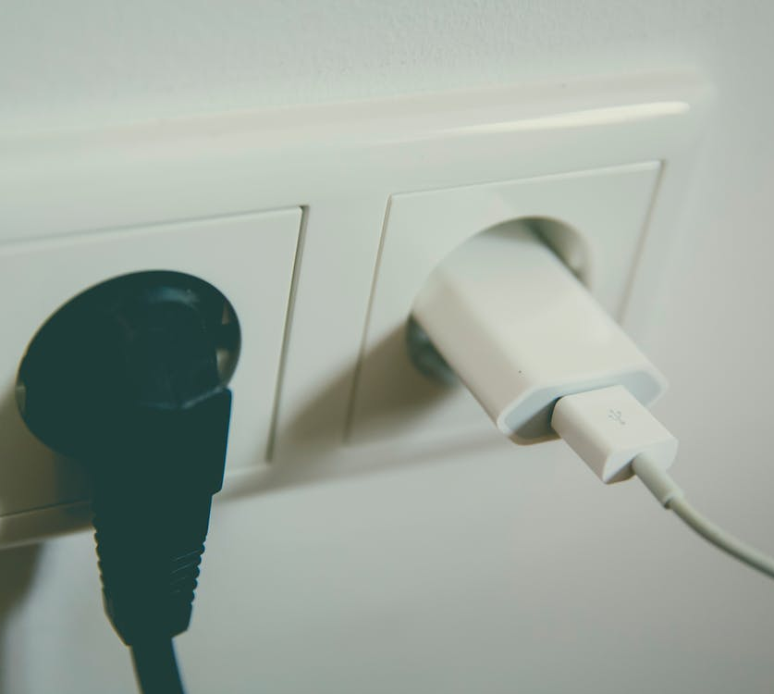
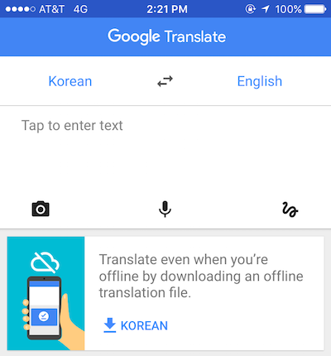
International Travel:
Points to Consider
Bring country-specific outlet adapters for all accessories
Most airplanes, hotels, and rental cars have USB outlets
Direct audio input cables for flight entertainment
  Or use Bluetooth streaming
Don’t be afraid to try other languages!

Slide 4
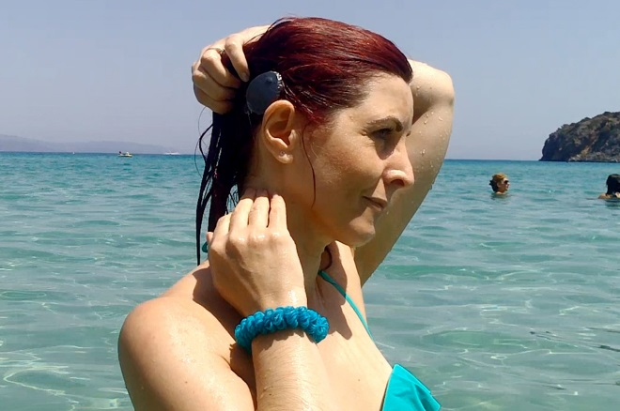
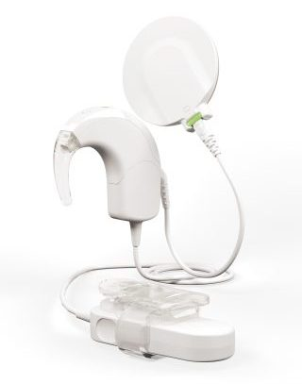
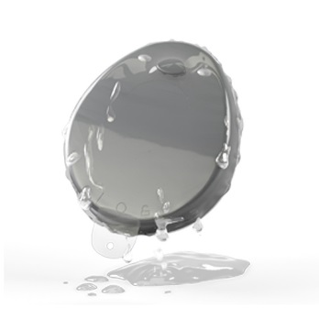
Swimming and Water
Use EarGear or similar cover product for humid/wet locales
WaterWear for swimming or other wet activities
Bring an extra microphone cover in case of moisture/dirt
Use tethers – “fish line”, BabyWear/ActiveWear for kids
Swim cap or
waterproof hat

Slide 5

Get Active With
Off-Ear processors
Custom made sports headbands or bandanas
Bring a loose-fitting hat
  Hats and larger headbands can also be used to secure other processors
Bring your preferred drying kit for afterwards

Slide 6
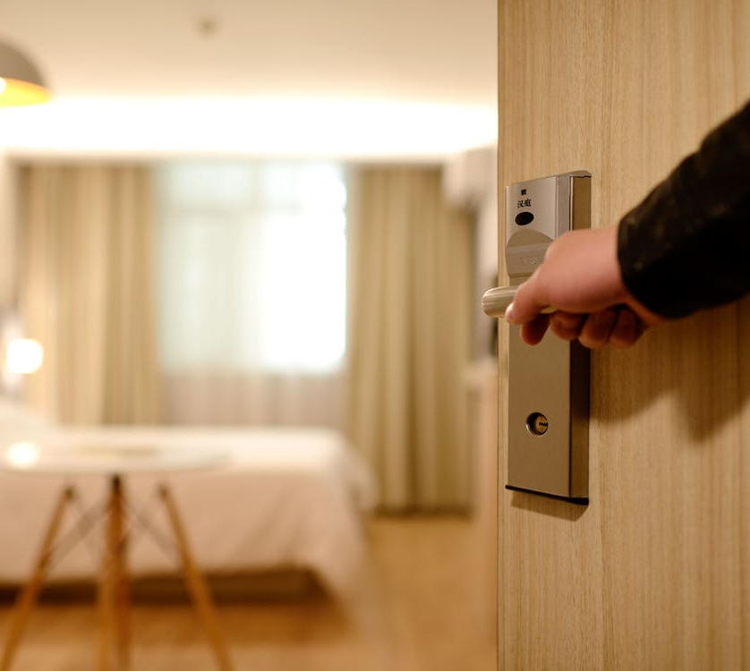

Other
Accommodations
Many hotels provide accommodations for HOH – vibrating alarm clocks, strobe fire alarms, etc.
  Call ahead to request these
Use telecoils where available – watch for the symbol
Use Travel Apps
Be open and ask for help when necessary!

Slide 7
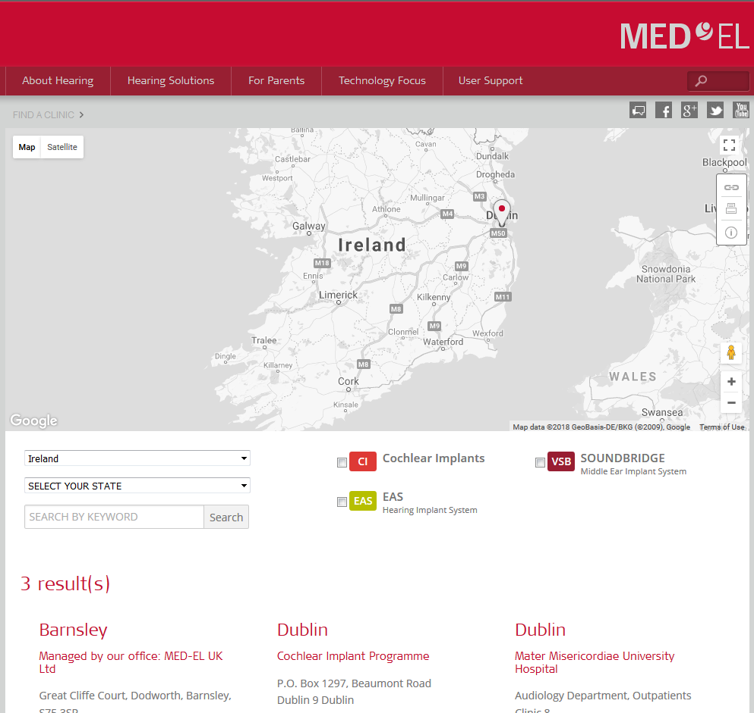
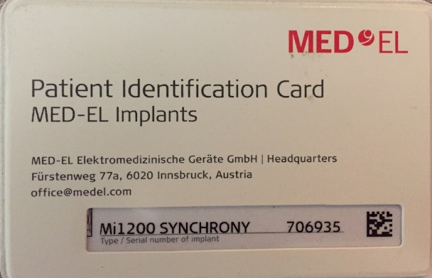
Find Support
Research clinic locations in advance for peace of mind
Carry patient ID card (I.C.E.)

Slide 8

Brief Pack List...
Batteries! Extras and backups
Battery Charger
Roger Pen or Bluetooth Device
Backup/alternate processor
Device Remotes
Travel/Storage Case
Patient ID Card
Outlet Adapters
USB Charging Cables
Direct Audio Input Cables
Roger Pen, Quattro, or other Bluetooth streaming device
EarGear or similar
WaterWear
Sport Headband and Hat
Tethers/Hair Clips
Drying Kit

Slide 9


Thank you!

