Slide 1
Tending to Hearing Loops in Your Community
Catherine Shanahan Juliëtte Sterkens, AuD Andrew Thomas

Slide 2
What we hope you take away from this lecture
The KEY elements of a functioning hearing loop Catherine Shanahan
Advertising and drawing attention to new loop installations in the community Juliëtte Sterkens
Ways to best handle a non-working hearing loop Andrew Thomas

Slide 3
Catherine Shanahan, Shanahan & New England Hearing Loop
President & CEO of Shanahan Inc. and award winning New England Hearing Loop
Since 1951, Audio Visual Integrator
Since 2011, Hearing Loop Design, Installation and Maintenance Services
Approaching 150 loop installs
Notes:
Installs in some of the most prominent facilities in New England:
Both the Massachusetts and Rhode Island State Houses
Unviversities – Harvard, Brown, Bowdoin
Symphony Hall, etc.

Slide 4
The Key Elements of a Functioning Hearing Loop

Slide 5
Building Hearing Loop Awareness
Uphill Battle
Educate People on the Hearing Loop Benefits

Slide 6
It’s All About the Commitment!
Advocates.
The Venue.
The Patrons.
Ongoing.
Notes:
Advocacy has to be there for EVERY Loop
The Venue – HAS to be committed from installation, to use to maintenance, to marketing
The Patrons – Their commitment is to Use it and share their experience good and bad
Ongoing – Once a loop is installed if the 3 above don’t all work, the loop is a failure.

Slide 7
It’s All About the Process
Measure
Discover
Build Relationship
ICE Standards
Site Review
Notes:
It begins with the ICE Standards (Insert STANDARD Number)
Measure - Electromechanical Admissions in the facility
Discovery – Construction of the room and the building, How is the room is going to be used and function, , constru

Slide 8
Challenges
Mechanical
Spillage
Other HAT
Fear of Change
Biases
Timing
$$
Scoring vs. Laying

Slide 9
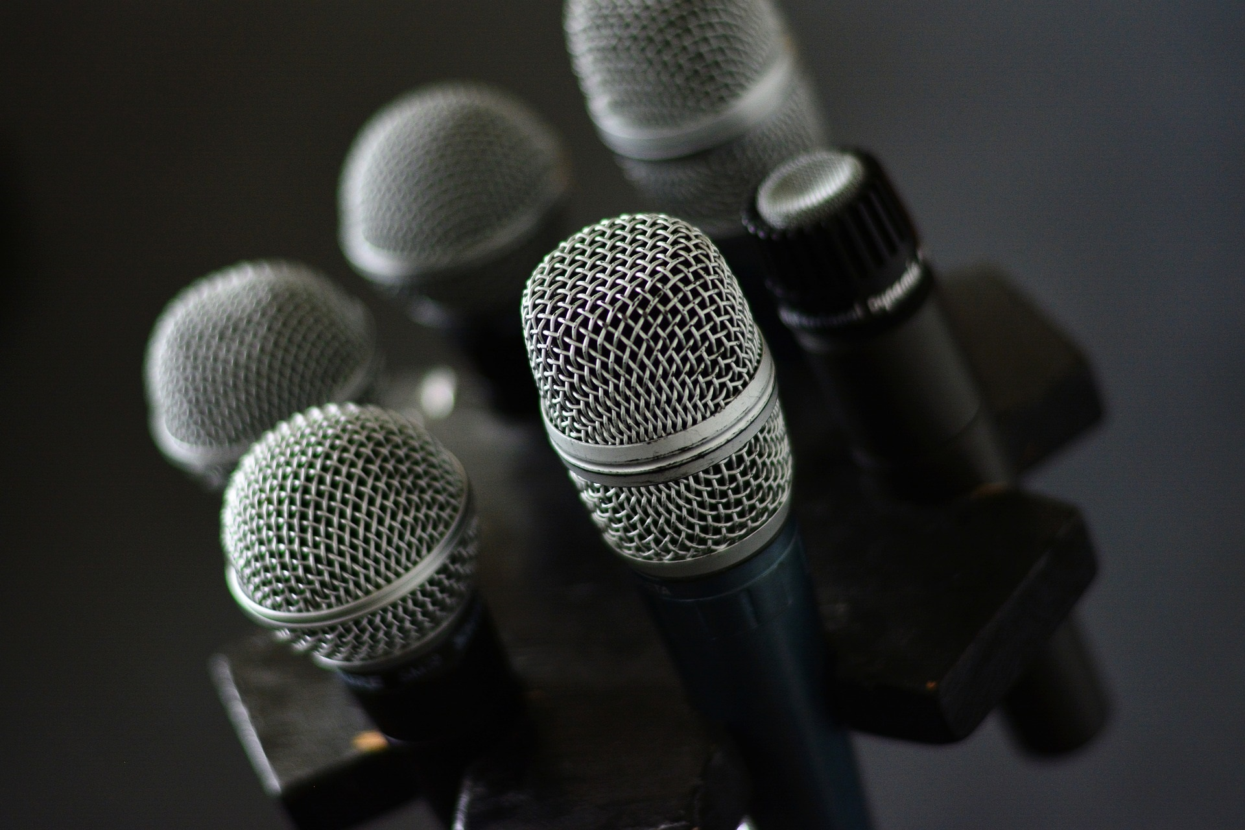
Importance of the Audio System
Notes:
Input – Microphone Selection

Slide 10
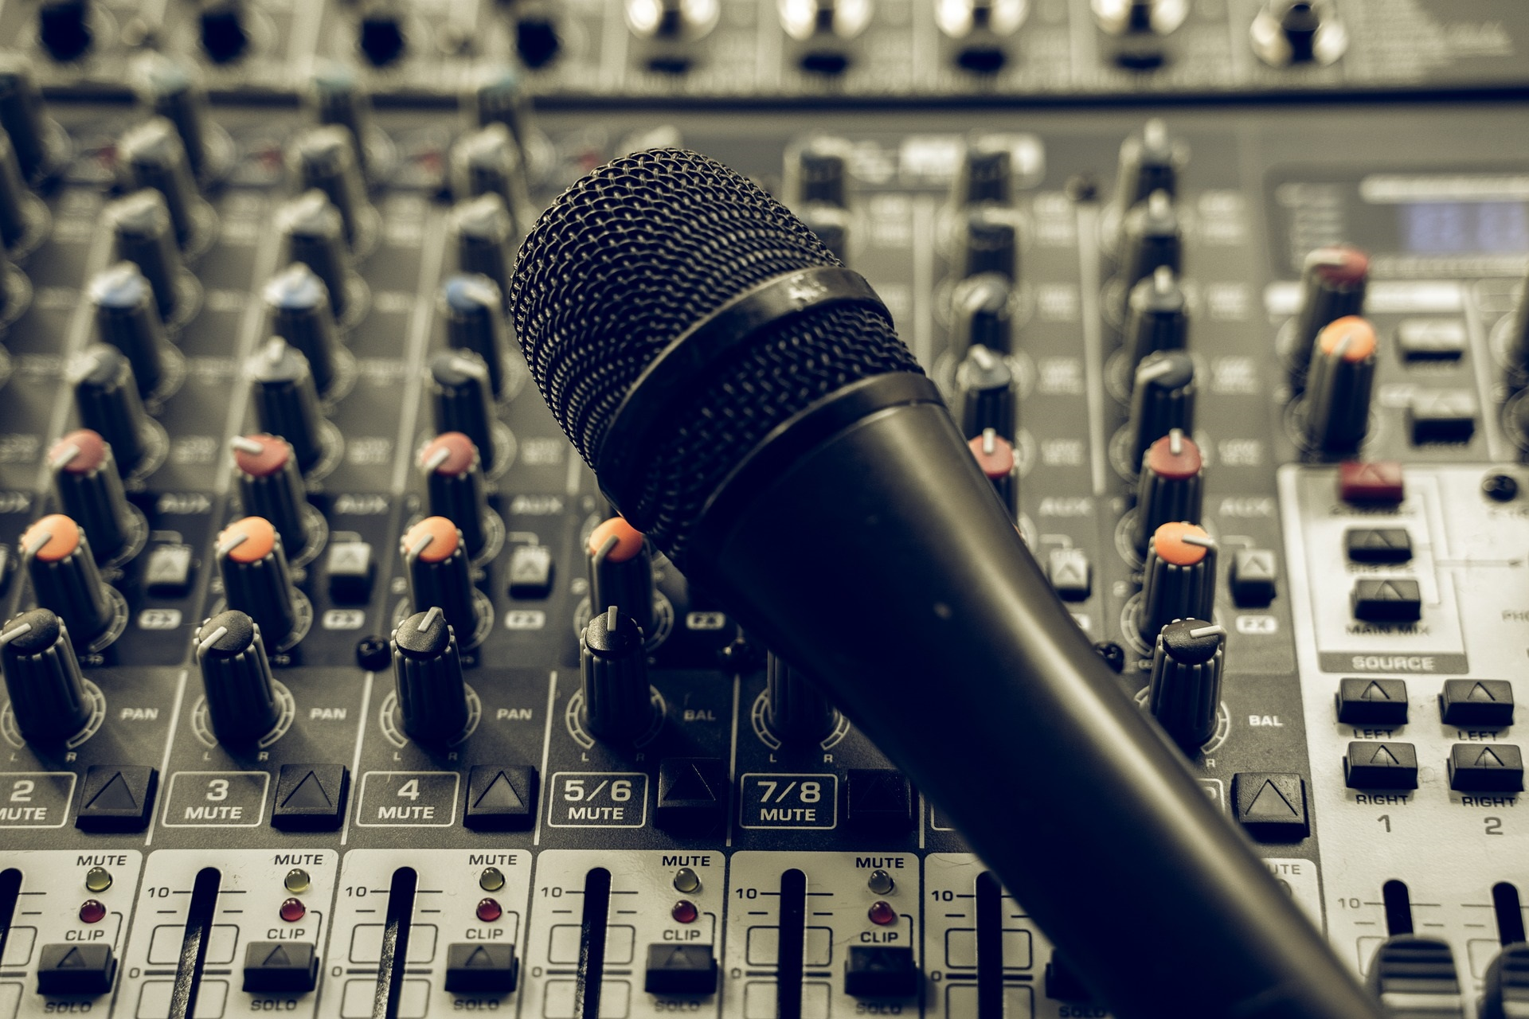
Importance of the Audio System
Notes:
Equalization, Mixing and Components

Slide 11
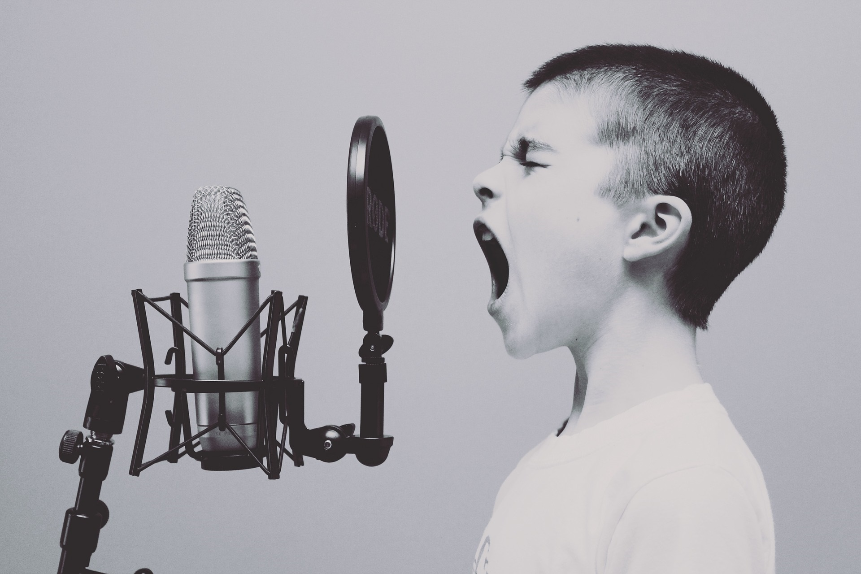
Importance of the Audio System
Notes:
Usage

Slide 12
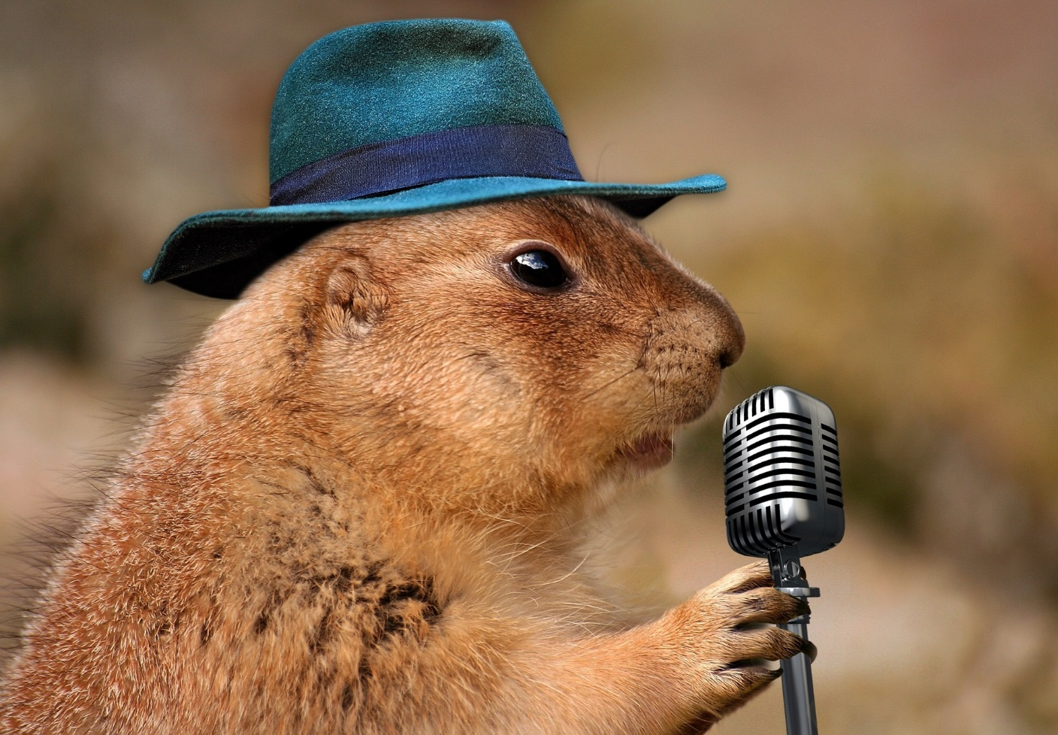
Importance of the Audio System
Notes:
Usage

Slide 13
It’s Still About the Process
Communicate
Retest
Coordinate
Redesign
Install
Test & Calibrate
Equalize System
Commission
Train
Its Installation Time!

Slide 14
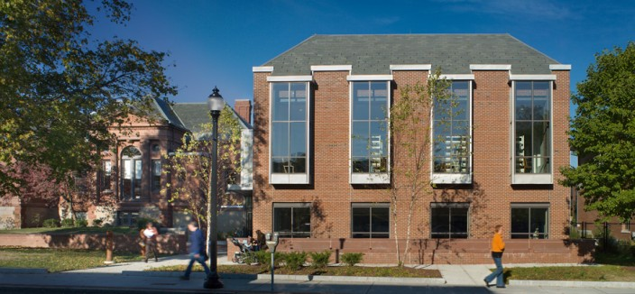
Watertown Free Public Library

Slide 15
After the Install
Venue
Installer
Remote Monitor
Support/Maintenance
Relationship
Add to the Loop Locator
Display Signage
Educate Patrons
Relationships
Promote!

Slide 16
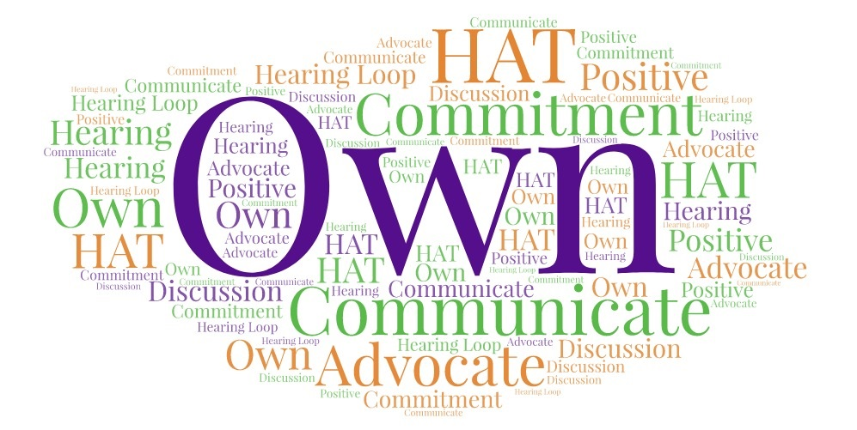
How to Work with Venues

Slide 17
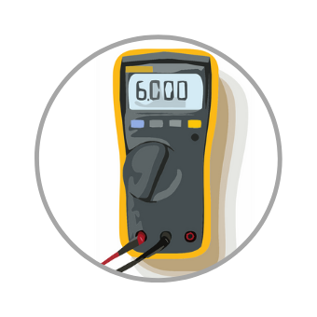
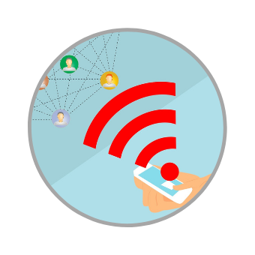
Sustainability

Slide 18
Contact Us
Email: Catherine@shanahansound.com
Websites: www.shanahansound.com www.newenglandhearingloop.com
Loop Locator: www.newenglandhearingloop.com/loop-locator

Slide 19
Advertising Your Hearing Loop
Juliëtte Sterkens, AuD Nearly 40 years of experience. Retired from private audiology practice in Oshkosh WI. HLAA’s National Hearing Loop Advocate since 2012 (Thanks to grant funding from David and Carol Myers Foundation) Helped foster 725+ loops in WI and many more around the country.
Member HLAA GITHL Committee
For questions: jsterkens@hearingloss.org
Website: www.LoopWisconsin.com
Notes:
*) If your church has a loop installed – make this part of your outreach. Email me – I am happy to help.

Slide 20
The Hearing Loop is Installed – Now What?

Slide 21
The Hearing Loop is Installed – Now What?
No 1. The community needs to be informed
House of Worship
Library
Theater
Retirement community
Government venue (Courtroom, County or City facility)
Commercial venue (Funeral home, audiology practice, museum, drive through etc.)
Notes:
This depends on the type of venue – let’s start with the lowest hanging fruit first
1. Houses of Worship -

Slide 22
Get familiar with social media
Facebook – please like & follow GITHL page
Twitter – Use hashtags #hearingloop, #telecoil and #hearingaids – @ symbol @HLAA, @GITHL1, @LoopWisconsin etc
PR on FB and Twitter is “Free PR”: good for networking, driving traffic to GITHL info pages, raising awareness of installations
What can you do to help the “cause”? Retweet or repost on your FB page
Notes:
Drive traffic to your web pages. Need website visitors? ...
2) Network with others. ...
3) Distribute content. ...
4) Communicate your brand. ...
5) Boost your SEO. ...
6) Improve your chances of purchase. ...
7) Reach a bigger audience. ...
8) Increase authority.

Slide 23
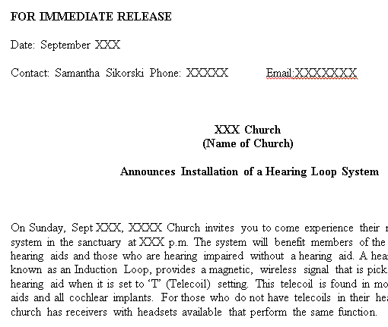
All venues benefit from a News Release
A few pointers:
The heading should contain action verbs
The first paragraph should answer the "who," "what," "why," and "where"
The press release should contain understandable language and a quote
Reach out to specific journalists
Don't be afraid to go offline – use snail mail
Notes:
Think of press releases as an opportunity to connect to the audiences you care about -- including, but not limited to, reporters. HLs are so new that many times it piques the interest of a reporter looking for community news.

Slide 24
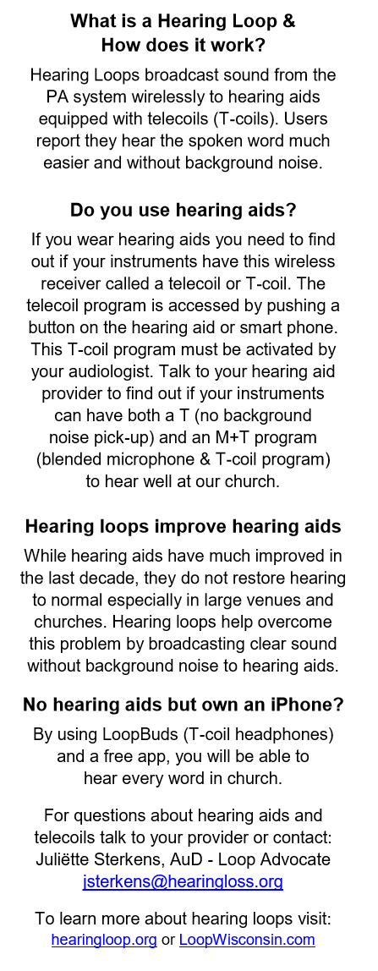
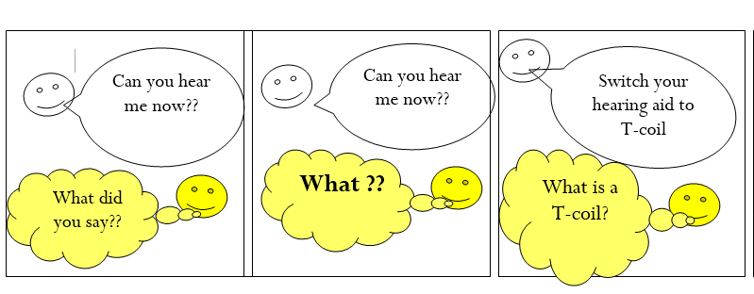
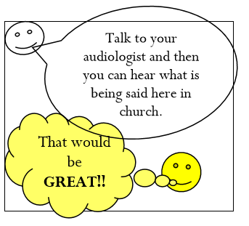
Inform venue patrons or members
A few pointers:
Bulletin inserts can educate many on one day
Encourage use of loop logo & “Hearing Loop Installed switch hearing aid to T-coil” notification *)
Better yet: A hearing loop dedication
Notes:
*) If your church has a loop installed – make this part of your outreach. Email me – I am happy to help.

Slide 25
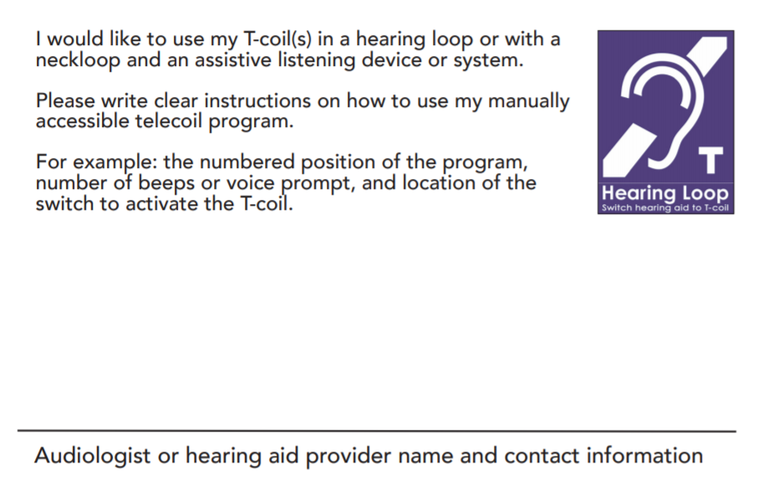
Inform venue patrons or members
A few pointers:
Offer an informational/educational flyer
Invite local audiologist to present a “How to Hear in Our New Hearing Loop” Lecture
Don’t forget to invite a local journalist

Slide 26
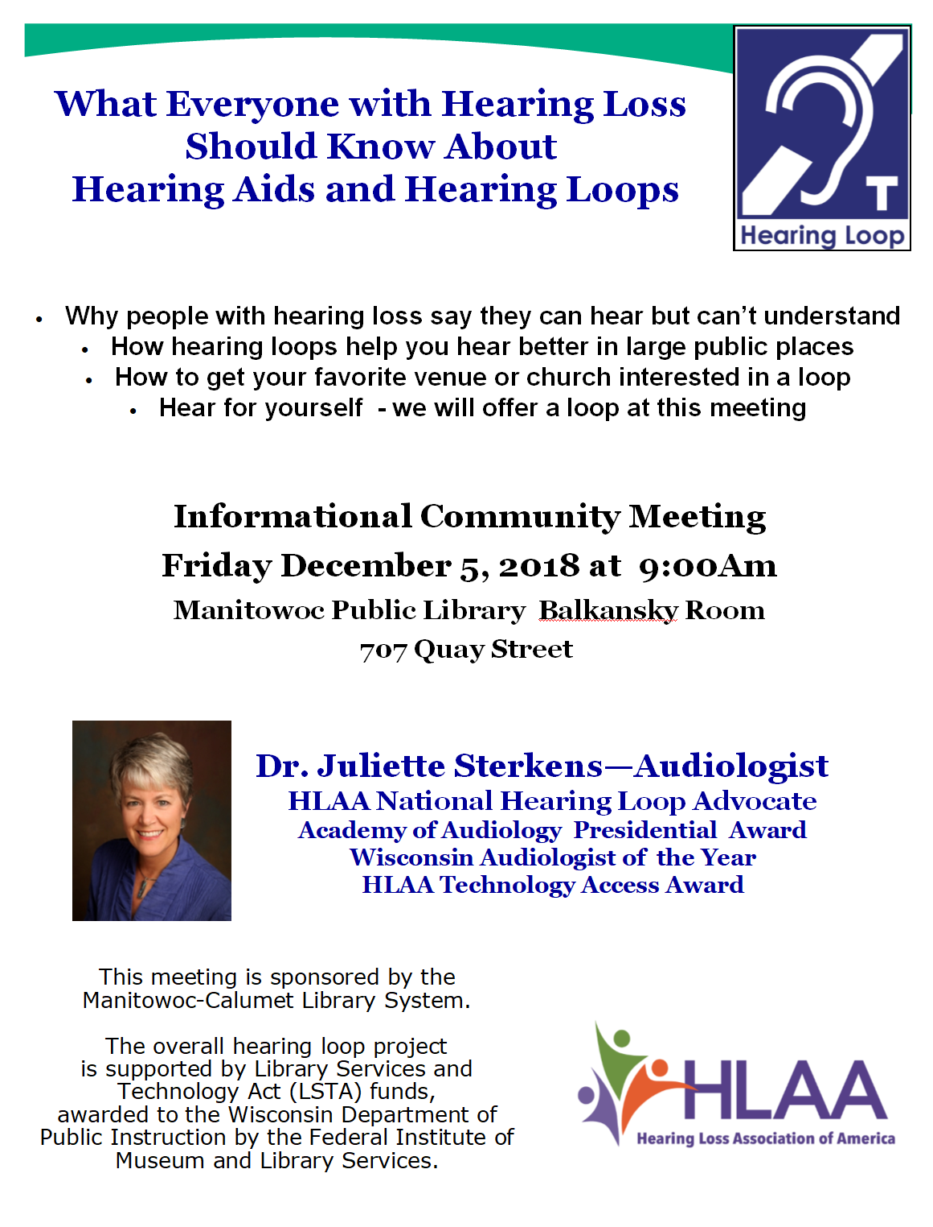
Libraries
A few pointers
LSTA Grant funding may be available
Many libraries are open to lectures or workshops by HLAA members or hearing care professionals

Slide 27
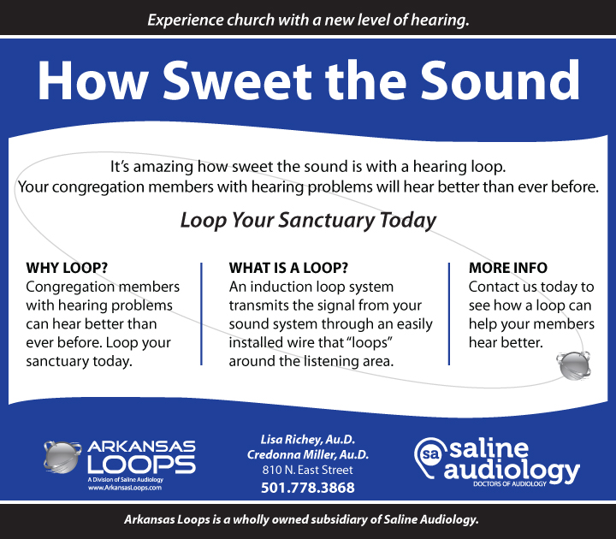
Hearing Care Providers
A few pointers
Share a list of local loops – when/where installed
Make a point to ask for your provider’s support
Praise providers who install a loop in their office
Encourage signage of the loop in the office & listing the loop on their website
Discuss providers can additional PR by listing it on www.hearingtracker.com

Slide 28
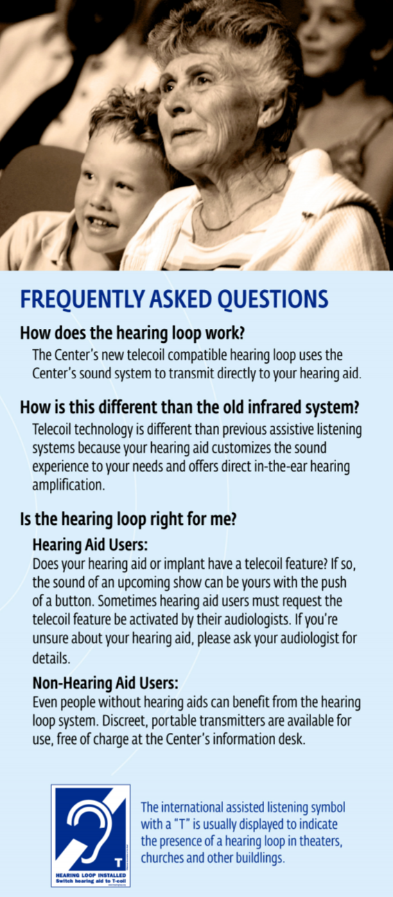
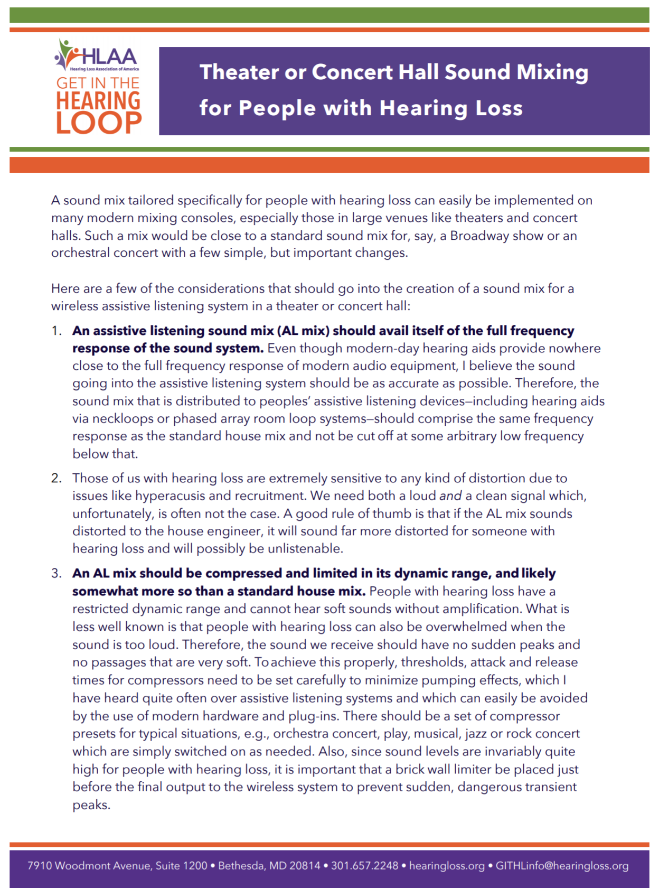
Theaters
A few pointers:
A variety of educational materials exist
Insist use of logo on Playbills
Announcement idea: “Please turn off your cellphone. Now is the time for hearing aid users to turn on their telecoil to hear in our Hearing Loop”
Offer Richard Einhorn’s “Sound Mixing for People with Hearing Loss”
Most theaters have a dedicated marketing person in charge of PR – offer your help
Offer to give the loop a listen during dress rehearsals
Tweet, post on FB – every time you have a good experience

Slide 29
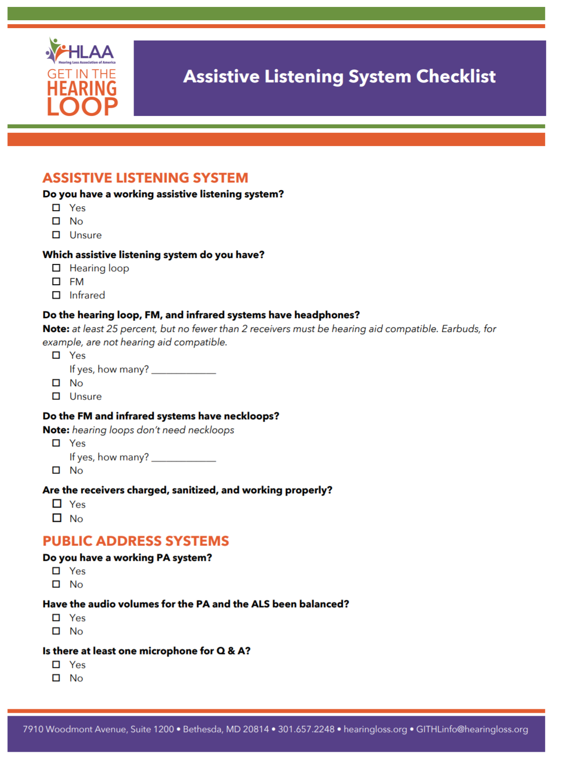
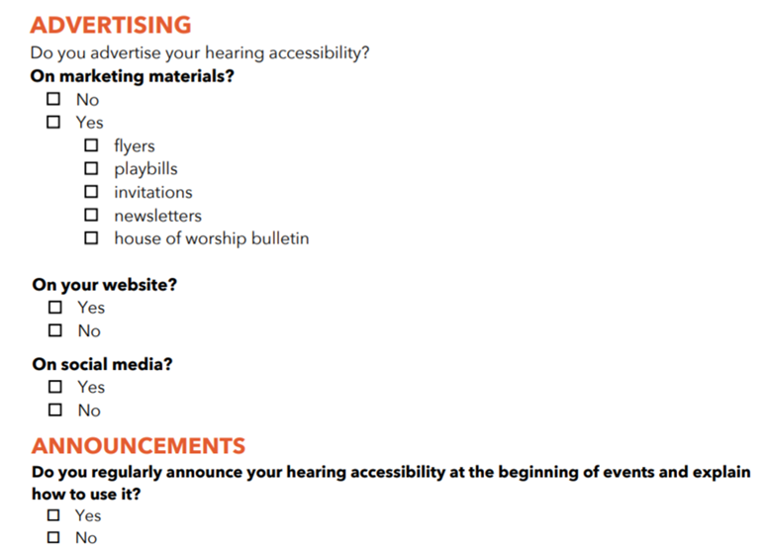
Created just for this purpose: GITHL “Assistive Listening System Checklist”
Use the checklist as your guide

Slide 30
And finally – Letter to the Editor:
A few pointers:
Something anyone can do
Praise the provider, venue or organization for improving hearing access and installing a hearing loop
Keep it short
When published: Take a photo and post on twitter and include @GITHL1 post on FB & include Get in the Hearing Loop FB group

Slide 31
Ways to best handle a non-working hearing loop
Andrew Thomas:
Market development director – Contacta
Chairman of IHLMA
Chairman of IHAC
Committee member of BS8300

Slide 32
How would you define a non-working loop?

Slide 35
Some reasons why a loop won’t work for you
Switched off
Not maintained or poorly maintained
Poorly Installed
Poor (or no) Signage
Wrong equipment has been specified
Its not where you expect it to be!

Slide 36
Managing expectations
Does the loop provide a benefit?
Do you know what a good working loop sounds like?
What experience have other T coil users had?

Slide 37
The sound source
The sound is bad!
The loop won't make a poor sound source sound great
What kinds of sound sources are there?

Slide 38
OK the loop doesn’t work now what?
Reporting it to staff/owner of the venue
How do they respond?
How do you follow it up?

Slide 39
The most important thing……..
Do something about it
Don’t be fobbed off
Share your experience with others
Involve your colleagues within the chapter

Slide 40
For more ideas read
“Hearing Loop Victory” July/Aug 2019 issue Hearing Life
We welcome emails: Athomas@contacta.co.uk jsterkens@hearingloss.org catherine@shanahansound.com

