Slide 1
Progress in Cochlear Regeneration
Patricia White, Ph.D.
Ernest J. Del Monte Institute of Neuroscience
University of Rochester School of Medicine

Slide 2
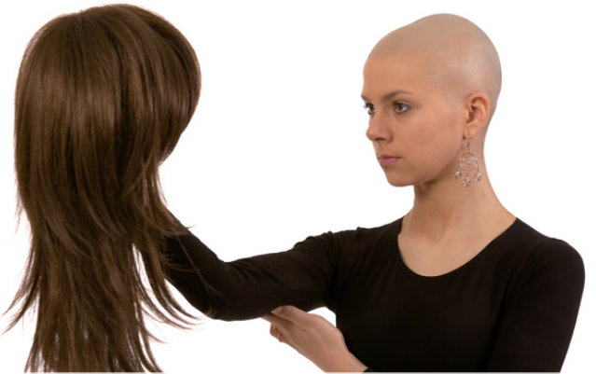
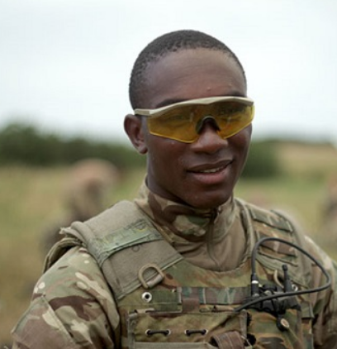
Acquired Hearing Loss
Chemotherapy
Antibiotics
Noise exposure
HIV (~30%)
Mumps (< 4%)
Measles (< 3%)

Slide 3
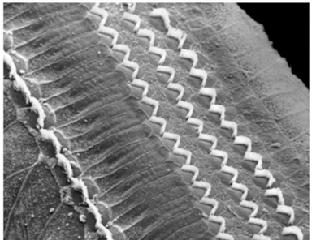
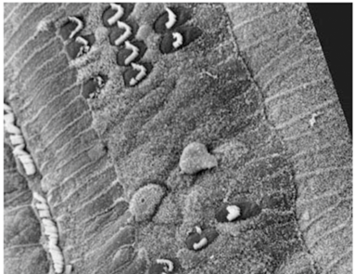
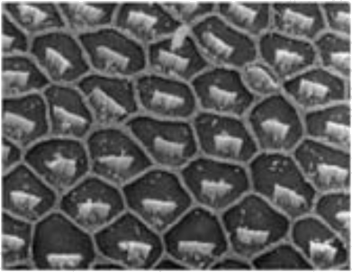
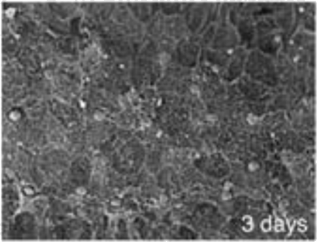
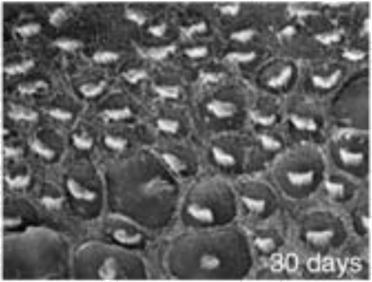
Mammals don’t regenerate lost cochlear cells
Image credit:
House Ear
Institute
But birds do!
Image credit:
Dr. Ed Rubel

Slide 4
In birds, natural regeneration leads to full recovery
40 days
Ryals et al, Hearing Research, 2013

Slide 5
Lost
Hair cells
Mitotic
Regeneration
Hair cells
Damage!
Supporting cells
Activated
Supporting cells
Direct
Transdifferentiation
Adapted from Jansson et al, Frontiers in Cell Neuro, 2015

Slide 6
Mouse supporting cells can differentiate into hair cell-like cells in culture
White et al, Nature, 2006

Slide 7
Mouse supporting cells can differentiate into hair cell-like cells in culture
Juvenile Supporting Cells
White et al, Nature, 2006

Slide 8
These results have been repeated and extended in hundreds of reports from dozens of labs
Spontaneous hair cell differentiation in damaged newborn mouse cochlea
Additional markers and further characterization of the stem-like cells
“Turning off” supporting cell genes along with “turning on” hair cell genes
Transcription factors
DNA accessibility
Candidate signaling pathways

Slide 9
Lost
Hair cells
Hair cells
Damage!
What activates supporting cells?
Supporting cells
Activated
Supporting cells
Adapted from Jansson et al, Frontiers in Cell Neuro, 2015

Slide 10
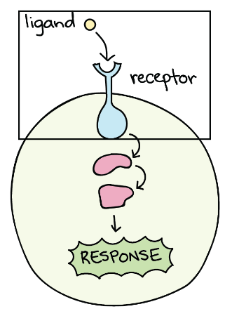
Candidate Signaling Pathways
NOTCH
WNT
Sonic Hedgehog
ERBB2 receptor family
Notes:
Unfortunately, a lot of biological molecules have names that are either nicknames, like Notch, or acronyms, like WNT, which is pronounce “Wint,” or the EGF receptor family. We call proteins that have a similar structure and function, or that work together, “family members,” there are 3 receptors similar enough to the EGF receptor that they are considered family members.
When I talk about a biological signaling pathway, I’m invoking a concept where a molecule called a ligand binds to a receptor and creates a response inside the receptive cell, which changes something about it. A ligand could be a molecule, like progesterone, or it could be a protein, like insulin. Some ligands, like estrogen, diffuse right across the cell membrane and bind to receptors inside the cell. Ligands might circulate throughout the body or they might only diffuse part of the way through a tissue. Ligands can also be bound to the surface of the cell that makes them, so that they can only affect the cells they contact.

Slide 11
Chicken supporting cells need ERBB2 family signaling to proliferate
White et al, Dev. Biol., 2012

Slide 12
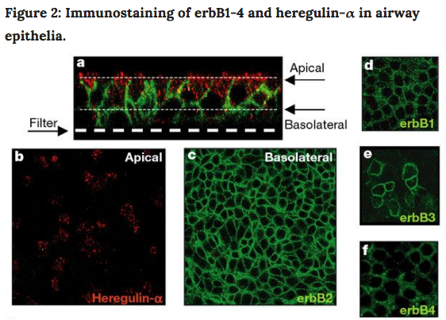
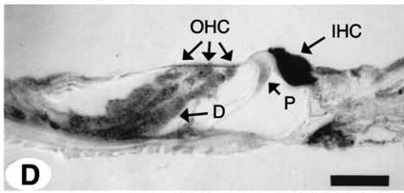
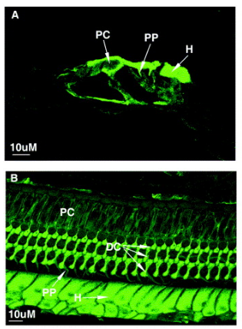
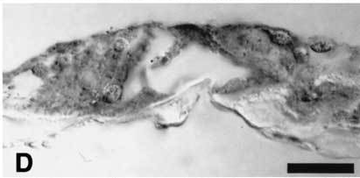
ERBB2 family members regulate regeneration in other tissues
Regenerating epithelial tissues
Receptor expression
Ligand expression
ERBB2
NRG1
ERBB3
Vermeer et al, Science 2003
Hume et al, JARO 2003
Zhang, Hear Res 2002
Ligands bind to receptors
Receptors drive changes

Slide 13
But, if mouse supporting cells can make hair cells, and if the pathway proteins are present, then why doesn’t the mouse cochlea regenerate?
Is the signal blocked?

Slide 14
Modern genetic tools enable the expression of activated ERBB2 receptor
Zhang et al, Eur. J. Neuroscience, 2018

Slide 15
Activating ERBB2 causes supporting cells to down-regulate a major marker
Zhang et al, Eur. J. Neuroscience, 2018

Slide 16
Activating ERBB2 drives formation of new hair cell-like cells
Control
Active ERBB2
Apical
Middle
Base
Zhang et al, Eur. J. Neuroscience, 2018

Slide 17
Others are taking complementary approaches
?
Drug
combinations
Transcription
factors
Newborn versus Adult
In Culture versus In Vivo

Slide 18
URMC
Colleagues
Jingyuan Zhang
Holly Beaulac
Jiatong Liu
Steve Paquette
Felicia Gilels
Sally Patel
Brooke Burgess
Luoying Yang
Gavin Jenkins
Aaron Rushdeen
Kwanza Warren
Lisa Shah
Nancy Bansbach
Lin Gan
Ken Henry
Chris Holt
Amy Kiernan
Rick Libby
Anne Luebke
Jonelle Mattiacio
Jenny Stone
Jian Zuo
MEEI
Funding
Quan Wang
Dunia Abdul-Aziz
Albert Edge
NIH R01 DC014089 (AE)
NIH R01 DC014261 (PW)

Slide 19
Repair of damaged cells may be as important as regeneration
Control
1 day
10 day
Cotanche, Hearing Research 1987

