Slide 1
It’s Not Just Them – It’s Us! Gael Hannan https://hearinghealthmatters.org Beth Wilson
Copyright © Gael Hannan 2019

Slide 2
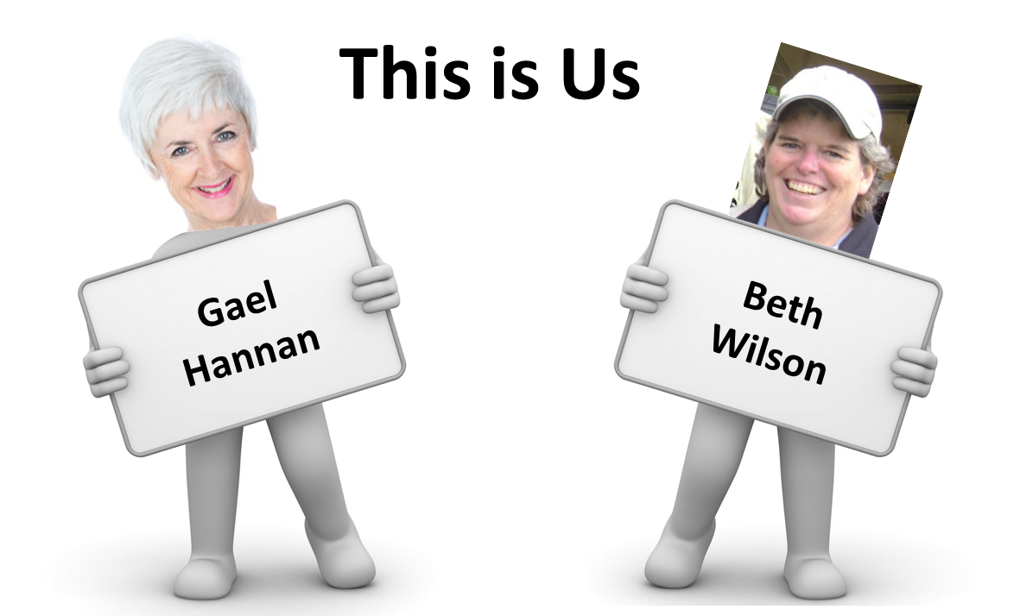

Slide 3
Communication Pendulum
No Strategy
Bad Habits
Good Behavior

Slide 4
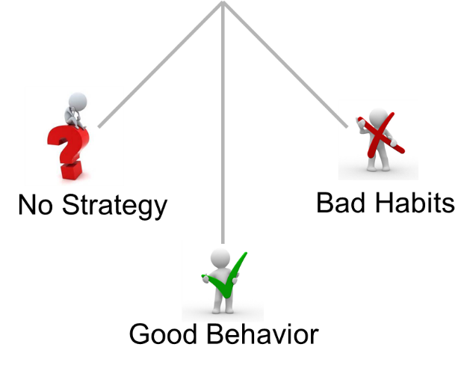
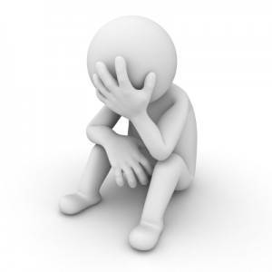
No Strategy
Don’t try to participate
Self-isolate
“I don’t deserve it”

Slide 5
Good Behavior
Assertive → Effective
Self-advocate
“I deserve it”

Slide 6
Bad Habits
Assertive → Aggressive
Self-sabotage
“I DESERVE it!!!!!!”

Slide 7
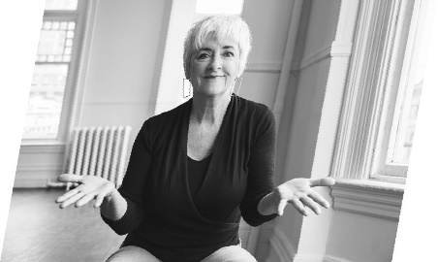
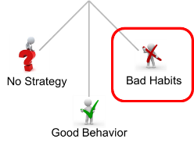
What Was I Thinking?
Talk to our communication partners from another room
Ask a question with our head in the vegetable drawer
Start a conversation without our hearing aid/CI
Bad Habit:
We don’t model
good communication
https://hearinghealthmatters.org/betterhearingconsumer/2018/5-errors-of-our-hearing-loss-ways/

Slide 8
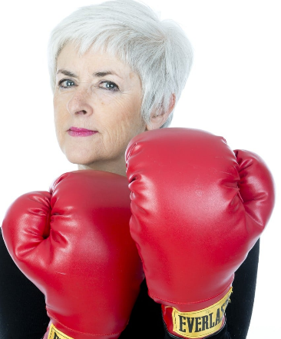
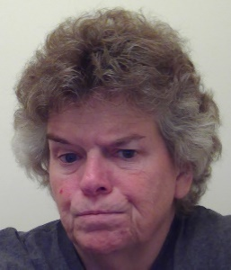
Aggressive Assertiveness
“I deserve to hear the punchline!”
“It’s your fault I can’t hear what’s going on”
Tend to be more aggressive with our family members
Have higher expectations (they should know better!)
They can’t escape us
Bad Habit:
We ask for patience
but don’t return it
https://hearinghealthmatters.org/betterhearingconsumer/2015/how-to-irritate-people-with-your-hearing-loss/

Slide 9
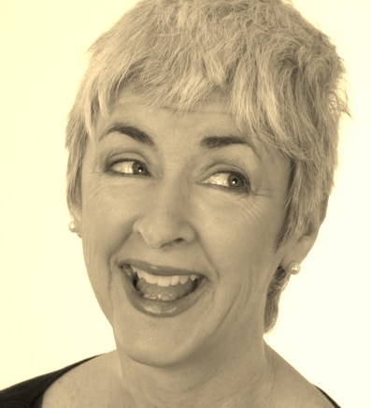
Bluff Like a Pro
Fake interest in the conversation
Copy other people (laugh when others laugh)
Make listening noises
Use facial expressions
Bad Habit:
We bluff
https://hearinghealthmatters.org/betterhearingconsumer/2015/how-to-bluff-like-a-pro/

Slide 10
Why Do I Hide It?
Answer question we thought we heard
Hiding a hearing loss leads to misinterpretation
Response doesn’t match (“they’re not very bright”)
Frown in concentration (“they disagree with me”)
Bad Habit:
We don’t self-identify
https://hearinghealthmatters.org/betterhearingconsumer/2018/5-errors-of-our-hearing-loss-ways/

Slide 11
Monopolize the Conversation
Dominate communication
Suck all the air out of the room
Bad Habit:
If I’m talking,
I don’t have to listen
https://www.gaelhannan.com/wp-content/uploads/2016/09/MC-HLAA-DC.jpg

Slide 12
Let’s Break Those Bad Habits!

Slide 13
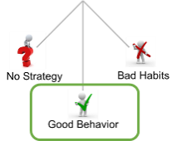
No Bluff Pledge
© Gael Hannon 2012
In my life, I will not bluff!
I will not pretend to understand
When I do not.
Instead I will do, all that it takes
To engage, interact and communicate!

Slide 14
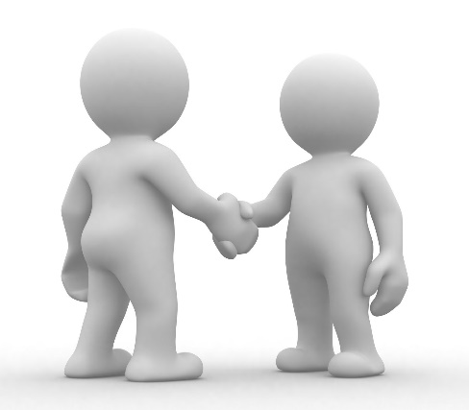
Take Responsibility
Ask for what we need
Model good communication behaviors
Patience with those who do not experience what we do

Slide 15
Situational Awareness
Am I helping or hurting?
Am I requesting or demanding?
Do my facial expressions match my words?

Slide 16
Verify and Clarify
“Did you just say ___?”
“Is it one-five or five-oh?”
“I heard ‘chicken’ but missed the rest of the special”

Slide 17
Model Good Communication
Face my communication partner
Don’t talk with food in my mouth
Don’t say anything I’m not prepared to repeat
Keep to one conversation
Don’t mumble

Slide 18
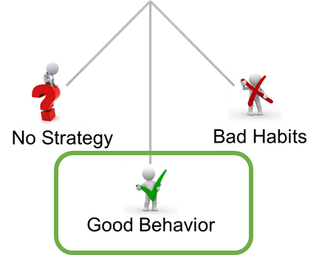
Summary
Recognize bad habits that sabotage effective communication
Assertiveness is good until it becomes aggressive
Model what we want to see from our communication partners
Transition bad habits into good habits

Slide 19
Them + Us =
Great Communication

