Slide 1
Genetic susceptibility to hearing loss from noise
Patricia White, Ph.D.
Department of Neuroscience
University of Rochester School of Medicine

Slide 2
Outline of this talk
Introduction
Noise Induced Hearing Loss (NIHL)
Physical Damage to the Cochlea from Noise
Genetic Mechanisms that Influence Susceptibility
Limitations of Animal Models in Use

Slide 3
Introduction The ear
Middle ear
Cochlea
Adapted from Chien et al, Molecular Therapy, 2016

Slide 4
Introduction The cochlea
2
3
0.4
1.5
0.6
20
1
4
Frequency (pitch) in kHz
Adapted from Chien et al, Molecular Therapy, 2016

Slide 5
Adapted from Chien et al, Molecular Therapy, 2016

Slide 6
Stria vascularis & Spiral ligament
Organ of Corti
K+
K+
Outer hair cells amplify sound
Inner hair cells detect sound
The lateral structures
are the cochlear battery

Slide 7
Inner hair cells send acoustic signals to the brain
The brain regulates the strength of the signal
Outer hair cells send pain signals only
Outer hair cells are also regulated by the brain
Cortical feedback

Slide 8
Introduction Cortical feedback
Dampens outer hair cell activity
Promotes signals within noise
Protects the cochlea from noise damage
Enables the enormous dynamic range of hearing

Slide 9
1 trillion times
the energy
Adapted from Basner et al, The Lancet, 2014
Notes:
We don’t perceive this difference as 1 trillion times louder, but we do perceive it as about a thousand times louder

Slide 10
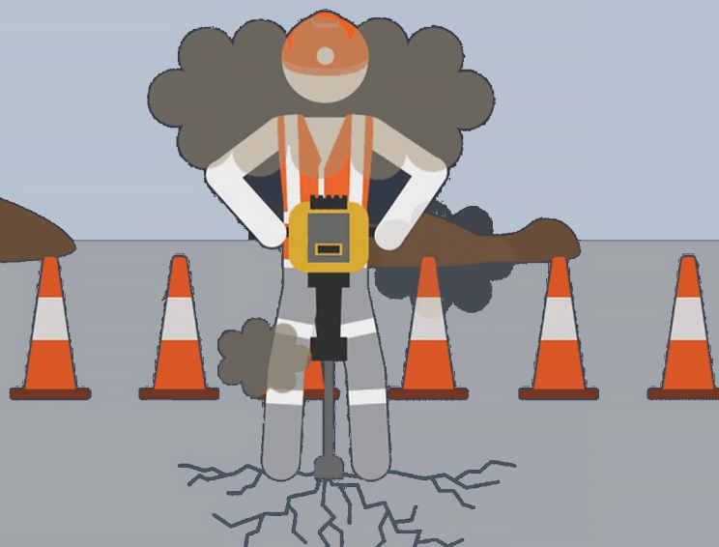
Occupational
Recreational
“Toughening?”

Slide 11
Parts of the ear:
Middle ear conveys the sound to cochlea
Lateral structures power the cochlea
Outer hair cells amplify sound
Inner hair cells detect sound
Inner hair cell synapses encode sound
Brain provides feedback to the cochlea about sound levels
Sound frequencies affect different places on the cochlea
Typical hearing covers an enormous range of sound energy

Slide 12
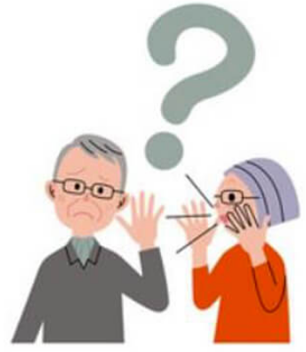
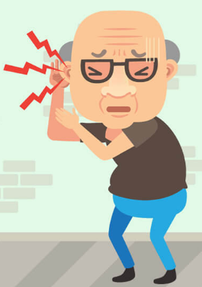
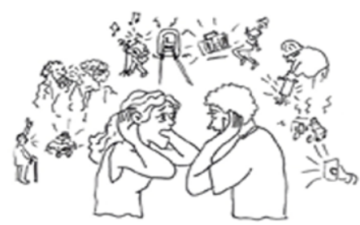
Noise induced hearing loss
Hearing Loss
Tinnitus
Problems hearing in
noisy backgrounds

Slide 13
Outer hair cell loss
Gilels et al, Scientific Reports 2018

Slide 14
Hair cell damage
Gilels et al, Scientific Reports 2018

Slide 15
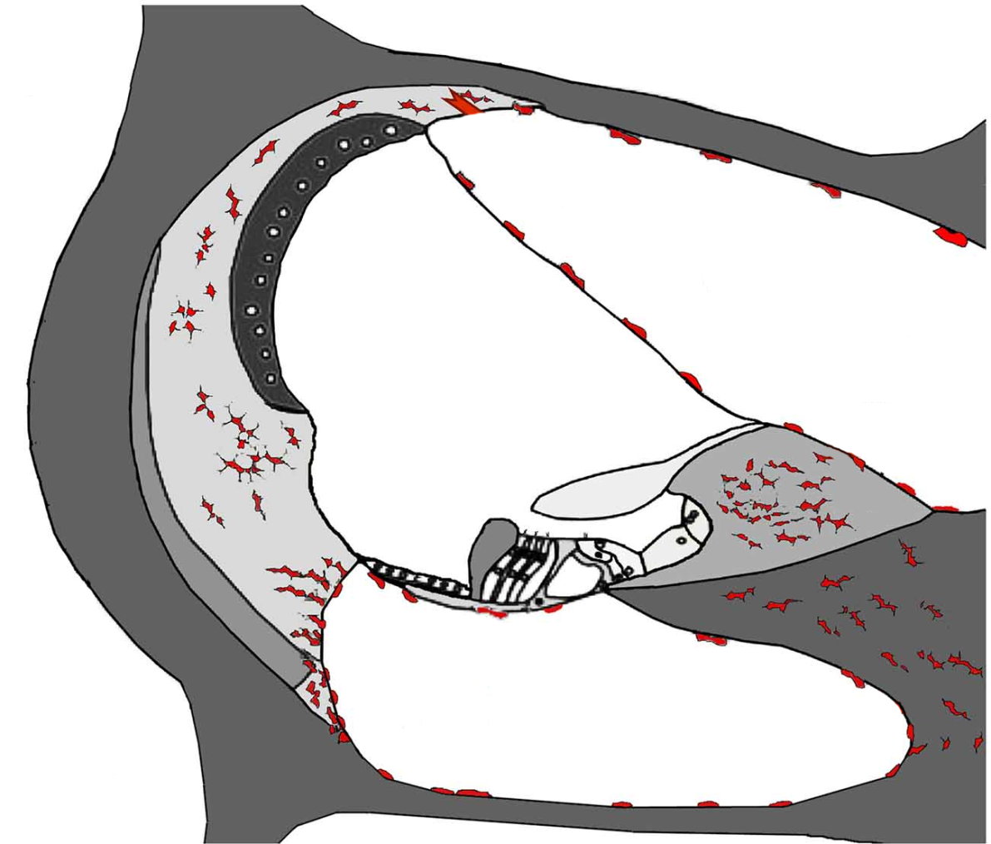
Inflammation
Adapted from Kalinec et al, Frontiers, 2017

Slide 16
High frequency synaptic loss
Kujawa and Liberman, Hearing Research 2015

Slide 17
Fitting cellular damage to symptoms
Outer hair cell damage and lateral structural changes -> hearing loss
Synaptic loss -> hearing in noise difficulties
Changes to cortical feedback -> tinnitus

Slide 18
Questions?

Slide 19
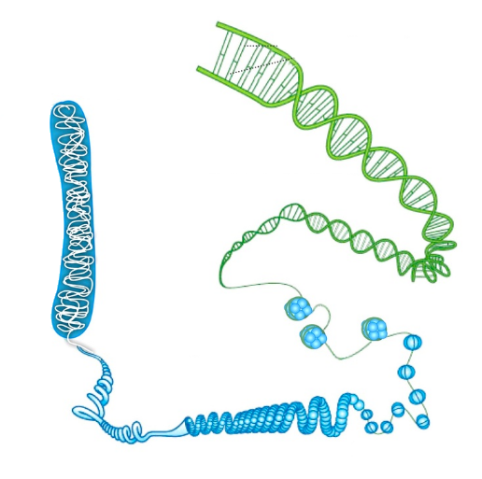
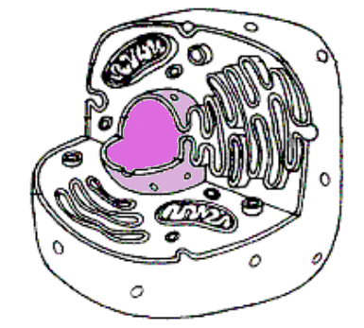
DNA solves more than crimes!
All cells in one person have the same DNA

Slide 20
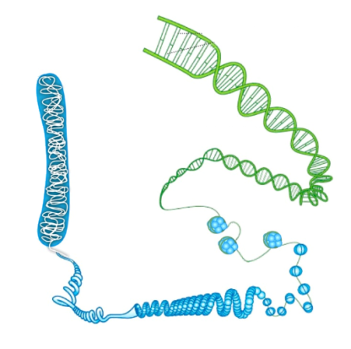
DNA Facts
DNA has a code - A, T, G, C – called base pairs
A pairs with T
G pairs with C
Differences between people are called variants
Base pairs “spell out” genes
Most genes make proteins
The code also specifies when proteins are made, and in which cells

Slide 21
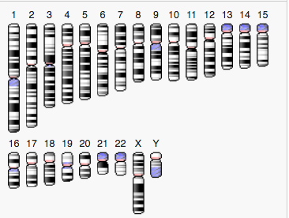
DNA is packaged in chromosomes
 | Chr22 | Whole genome
Base pairs | 51 Million | 3 Billion
Genes | 488 | 20,000
Adapted from PubMed Genome Viewer

Slide 22
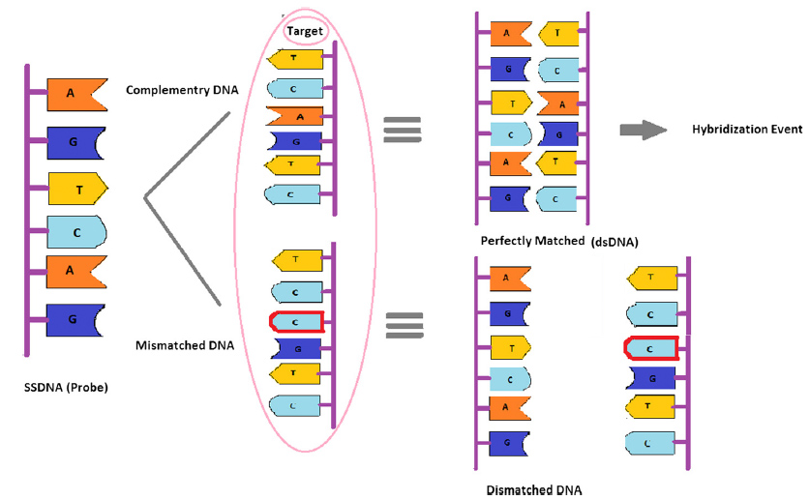
Hybridization
Adapted from Karimi et al, Nanoscale Res. Lett. 2014

Slide 23
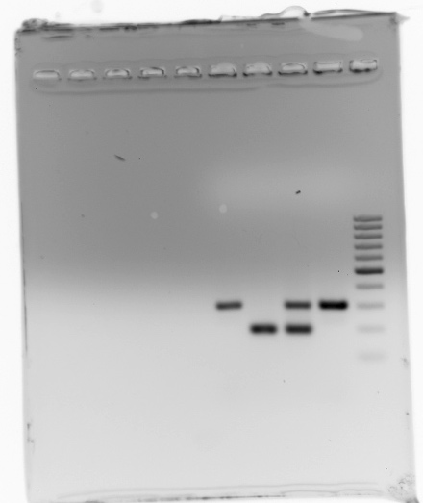
PCR:
Polymerase Chain Reaction
Original DNA
Mutated DNA
Adapted from Wikimedia Commons

Slide 24
Questions?

Slide 25
DFN gene mutations cause hearing loss

Slide 26
Noise induced hearing loss (NIHL) genes

Slide 27
Classifying NIHL genes by function
35%
Oxidative
stress
30%
DFN
13%
Regulators

Slide 28
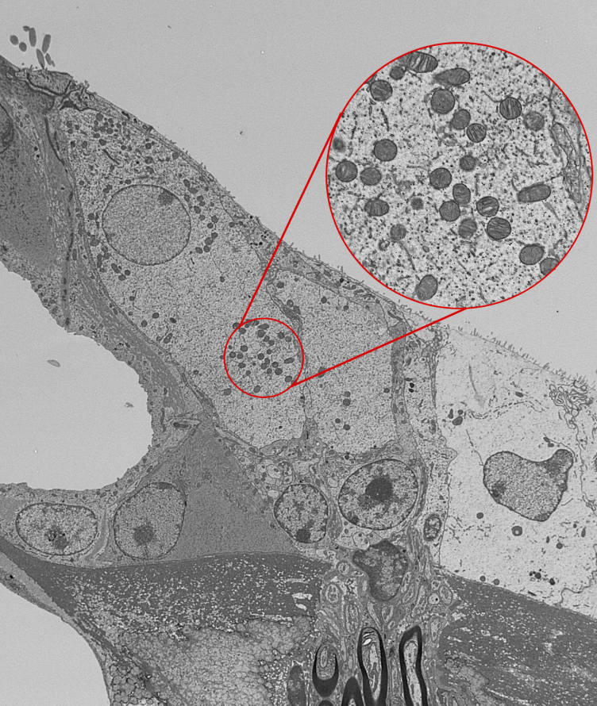
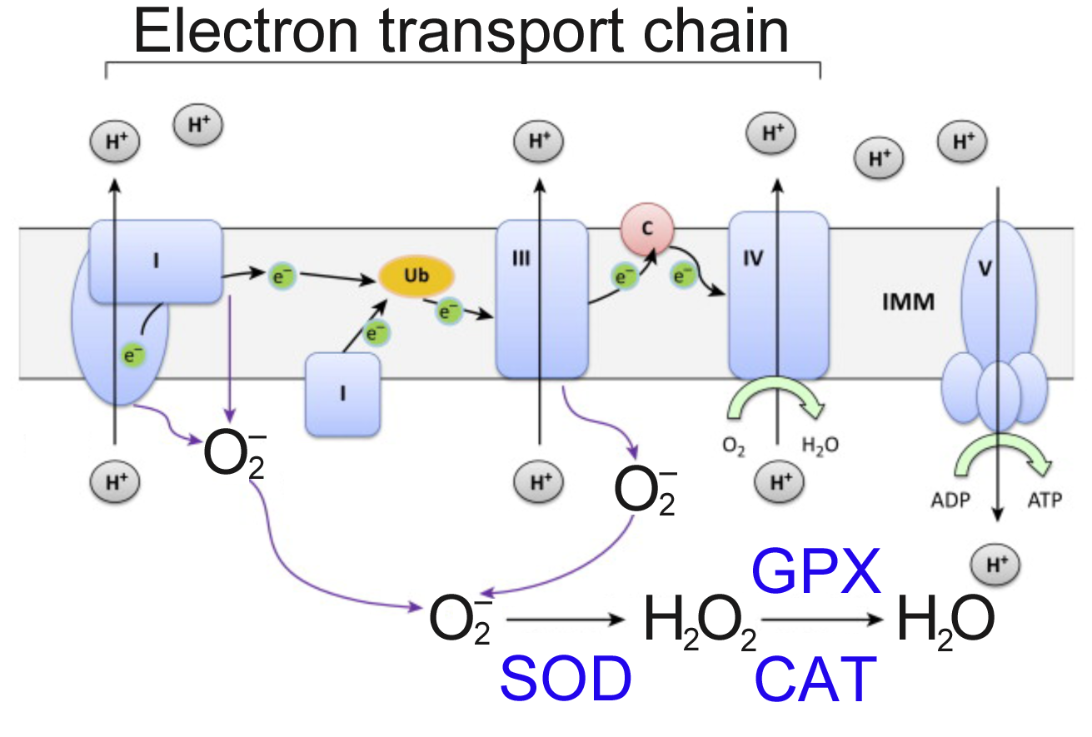
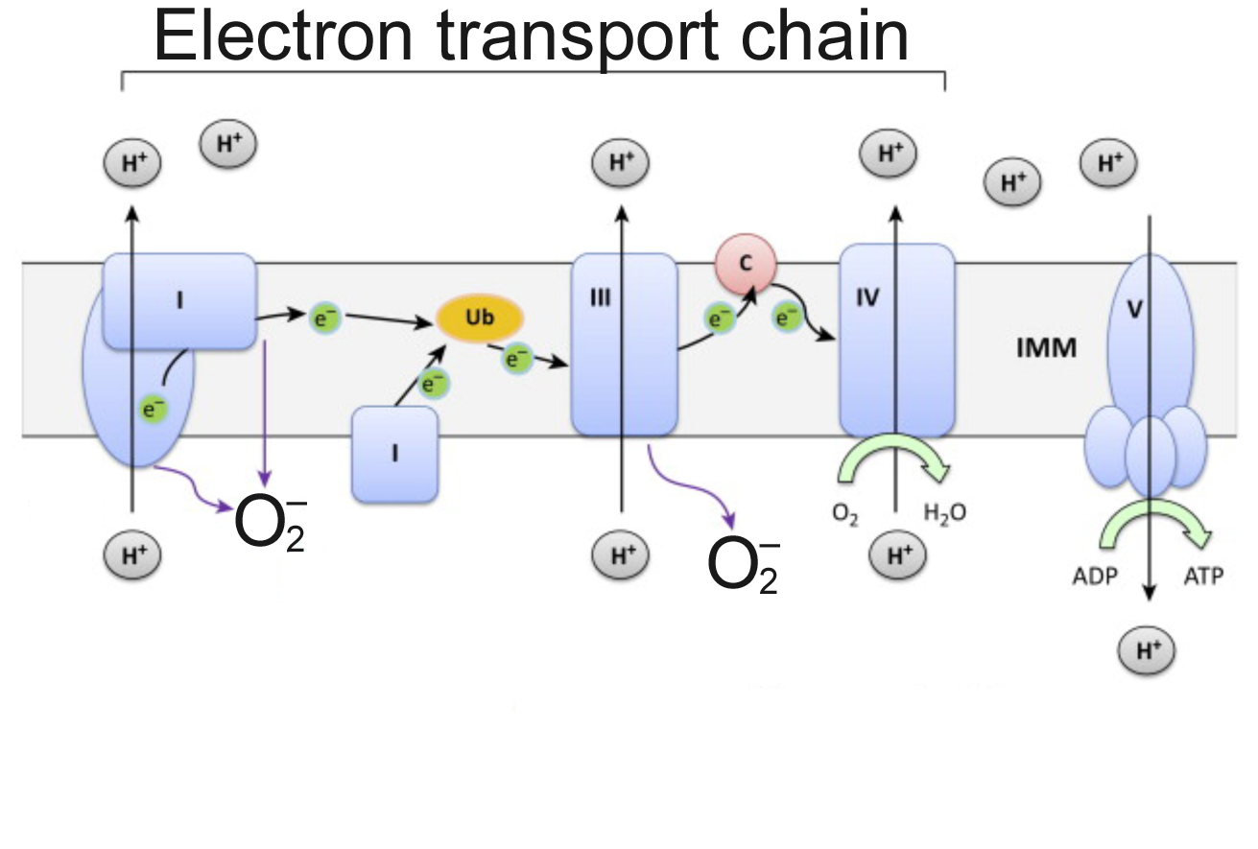
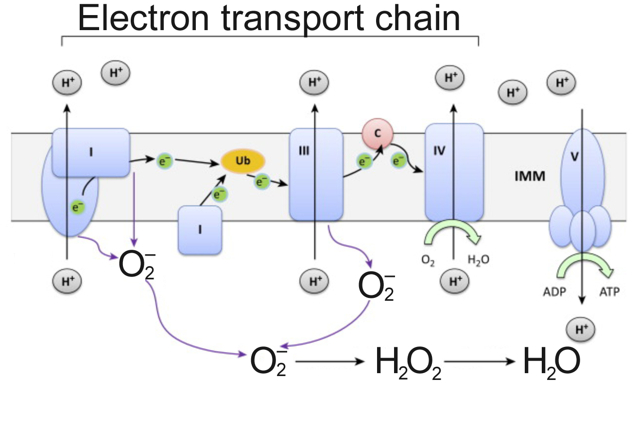
Mitochondrial breakdown drives oxidative stress
Diagram adapted from
White, unpublished

Slide 29
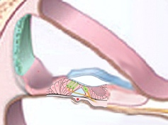
Which cells are most affected by oxidative stress?
Prediction:
Causes hearing loss
Lateral structures
Outer hair cells

Slide 30
Summary: Genetic variants in NIHL genes reduce resilience to occupational noise
3 major classes of NIHL genes
DFN, Regulatory, and Oxidative stress genes
The response to noise is energy intensive, requiring mitochondrial function
Mitochondrial breakdown drives oxidative stress
Cochlear cells that use more energy are vulnerable to noise
Animal models of NIHL variants can be used to characterize resilience

Slide 31
Questions?

Slide 32
Animal models: Why use them?
Cause
Conditions
Effects

Slide 33
Noise induced hearing loss
Hearing Loss
Tinnitus
Problems hearing in
noisy backgrounds
Good
models
So-so
models
No
models

Slide 34
Investigating FOXO3, an NIHL gene
Gilels et al, Sci. Reports 2017
ABR: Auditory Brainstem Response

Slide 35
Outer hair cells are lost in the FOXO3-KO
Control after noise
FOXO3-KO after noise

Slide 36
Do genetic factors drive tinnitus?
Tinnitus can precede hearing loss in some DFN patients
Tinnitus is thought to arise from CNS hyperactivity
Tinnitus can be sporadic, making it difficult to study
Risk factors include noise exposure, stress, anxiety, hypertension, hearing loss
Half of patients have no risk factors
Tinnitus
Notes:
Tinnitus can be part of a genetic syndrome, and it is often associated with early onset hearing loss. A number of DFN mutations present with tinnitus prior to the loss of hearing.

Slide 37
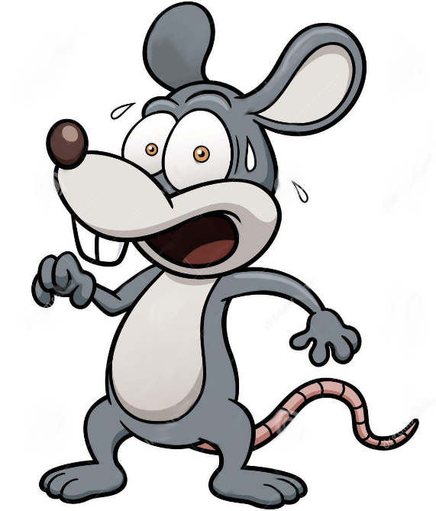
No known genetic variants for tinnitus
Could be a multi-factoral genetic basis
Animal studies use inhibition of the startle response – quite variable and restricted in utility

Slide 38
Do genetic factors influence poor perception of speech in noise?
Problems hearing in
noisy backgrounds
Open question!

Slide 39
There are currently no animal models to study speech perception in noise
Better understanding of mouse vocalizations -> new assays
No genes for modifying speech perception in noise have been identified

Slide 40
Summary: Genetic susceptibility to hearing loss from noise
Noise induced hearing loss disorders include hearing loss, tinnitus, and problems hearing speech in noise
Noise can damage or kill outer hair cells, drive inflammation of the lateral structures, and disrupt synapses
Outer hair cell loss and lateral structural damage are associated with hearing loss
Synaptic loss might affect hearing in noise

Slide 41
Summary
Two dozen genetic mutations conferring susceptibility to noise damage have been identified in people
~1/3 are in known DFN genes
~1/3 are in oxidative stress reduction genes
Sudden energy needs, like noise exposure, drive oxidative stress
Outer hair cells and lateral structural cells are uniquely vulnerable

Slide 42
Summary
Animal models for hearing loss can help explain cause and effects in noise damage
There are good animal models for hearing loss
There are crude animal models for tinnitus
There are no animal models for speech perception in noise

Slide 43
Questions?

