Slide 1
THE COMPLEXITIES OF GENETIC HEARING LOSS
POPULATIONS AND PEDIGREES
HELA AZAIEZ, PhD
Notes:
30 slides is too many – see my suggested cuts.

Slide 2
Hearing loss can run in families. When it does, that’s important to know and understand. My laboratory studies the genetics of hearing loss. Using advanced methods such as genome sequencing, we find the specific genetic errors that lead to familial hearing loss. To date we’ve identified many varieties of familial hearing loss. In the future, we hope that a detailed understanding of the genetics of hearing loss will lead to novel ways to prevent and treat hearing loss.

Slide 3
Genetic Hearing Loss
The most common sensory deficit in humans
Affects 278 million people worldwide
  Over 150 genes
Deafness
1/500
Down Syndrome
1/800
Spina bifida
1/2,000
Sickle Cell
1/3,000
PKU
1/10,000
DMD
1/3,500
Thalassemia
1/25,000
  Congenital Prevalence
Notes:
“Deafness” has a particular meaning in the HLAA context – typically it refers to people with congenital severe/profound loss.
Might want to clarify: ”here I’m talking about people who are born deaf and people who may lose hearing over time.

Slide 4
INNER EAR
OUTER EAR
MIDDLE EAR
Notes:
This will be familiar to the audience – you can do it quickly.

Slide 5
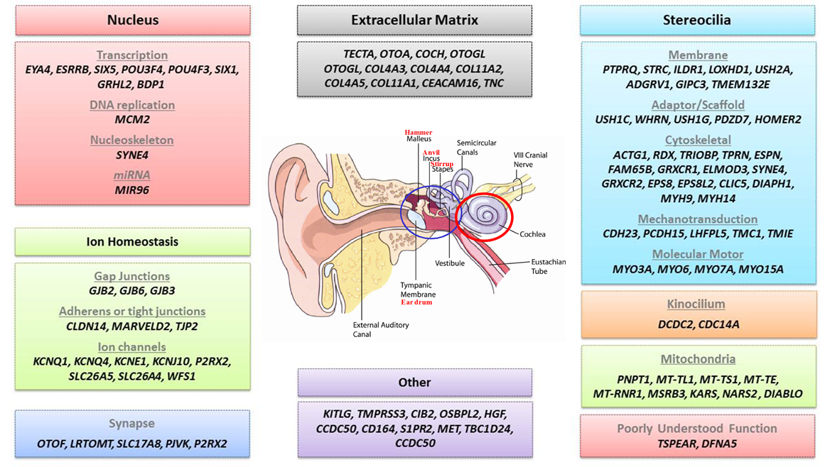
Notes:
This is fascinating, but of course way too detailed to cover in depth.
Perhaps simply, “Hearing geneticists have identified genes that that correspond to defects in many different parts of the ear” – for example, some genetic defects affect hair cells, others affect particular part inside of cells”

Slide 6
Some key vocabulary:
Phenotype = the way a person looks
Genotype = the genetic variations in a gene that a given person carries
One of the things we study is the relationship between a person’s genotype and the deafness/ hearing loss that is seen in that person.
To do this type of comparison, we (1) study pedigrees AND (2) screen all genes involved in hearing loss.
Notes:
** NEW SLIDE ***

Slide 7
PEDIGREES
Autosomal Dominant
Passed down from one generation to the next
Generations are not skipped
Both males and females are equally affected
Generation
I
II
III

Slide 8
PEDIGREES
Autosomal Dominant
Passed down from one generation to the next
Generations are not skipped
Both males and females are equally affected
Generation
I
II
III
Notes:
Suggest that you delete all of the slides that go into mode of inheritance.
This is probably too complicated for 15 minutes, and it is peripheral to your main point.
Perhaps just show just one.
“ You’ve all seen diagrams like in high school. These show families, with squares and circles being men and women. The black shapes are people who have the phenotype of interest – for example, they have hearing loss.” The white shapes don’t.”
These pedigrees come from old-fashioned genetics, but they are still key to our work today. Our team studies hearing loss that runs in families, and our work always starts with questions about phenotypc and pedigree: Who has hearing loss in your family?”

Slide 9
PEDIGREES
Autosomal Recessive
Usually NOT passed down from one generation to the next
Generations are skipped
Both males and females are equally affected
Generation
I
II
III
Notes:
Delete

Slide 10
PEDIGREES
Autosomal Recessive
Usually NOT passed down from one generation to the next
Generations are skipped
Both males and females are equally affected
Generation
I
II
III
Notes:
Delete

Slide 11
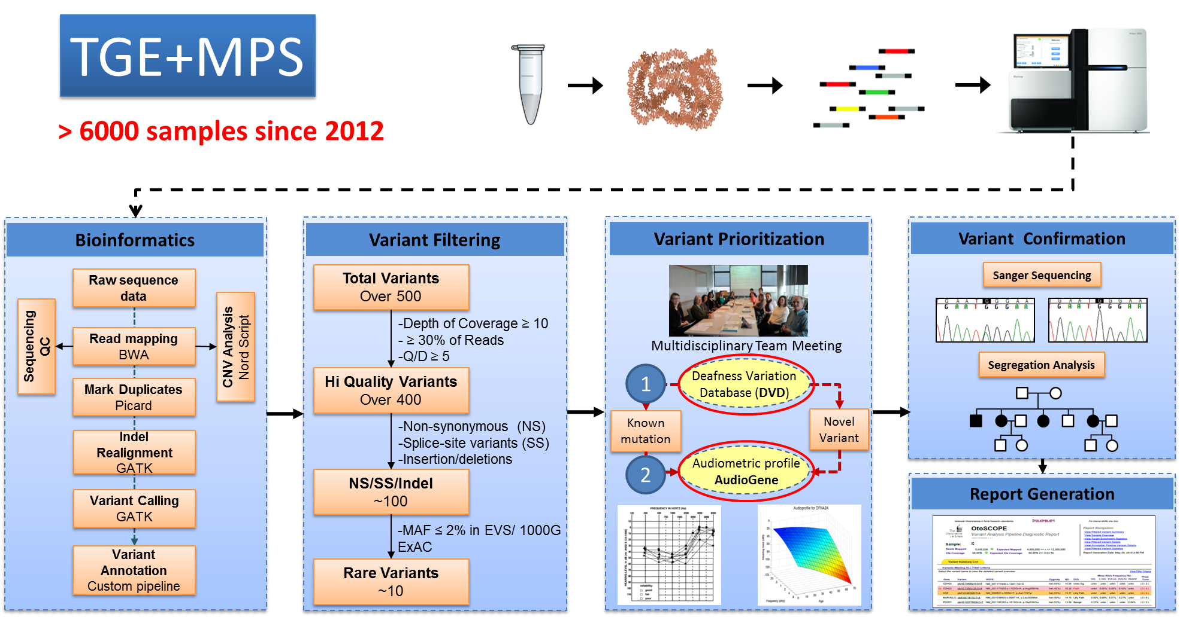
Screening ALL Genes Implicated in Hearing Loss
Complicated process that requires multiple steps
All genes can be studied simultaneously
Notes:
Once we get the pedigree from a family, we test family member’s genes – by testing their blood.
It used to be that we had to test people’s gene-by-gene.
Technical advance (in chemistry, in math) have made it possible to test (thousands)? of genes at once.
With information about thousands of genes, and with the help of computers, we close in on the gene that likely caused hearing problems in that family.
(Obviously there’s more to this story – I just don’t know what it is).

Slide 12

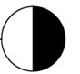

Lessons Learned
There is complexity at the genetic level
= White forelock
= Hearing loss
Findings
7 y/o boy with congenital severe hearing loss
Family history–mother has white forelock; mother’s father has premature grey hair and hearing loss in one ear
Prior testing for Waardenburg syndrome NEGATIVE
Notes:
I want to tell you a story about how detailed genetic information can help make sense of phenotype and pedigree
My lab recently saw a boy who, based on his pedigree, looked like he had something called Waardenburg syndrome --- that as syndrome that phenotypically appears as someone with white hair in the front, and hearing loss.
Interestingly, singe-gene testing said that the boy did not have Waardenburg syndrome.
But we dug deeper.

Slide 13
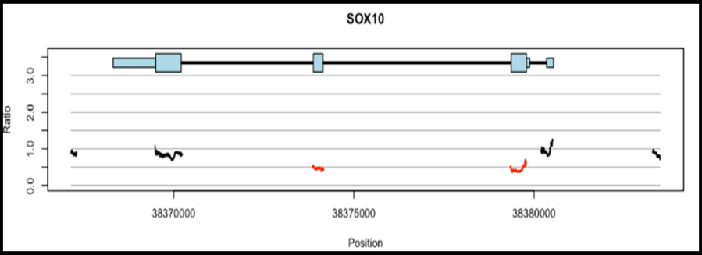
Lessons Learned
CNVs are related to the hearing loss in 15% of persons with genetic deafness
= White forelock
= Hearing loss
Diagnosis
Based on the ability to identify and resolve large pieces of missing DNA – called copy-number variations
  Two-exon deletion of SOX10
Waardenburg Syndrome
Findings
7 y/o boy with congenital severe hearing loss
Family history–mother has white forelock; mother’s father has premature grey hair and hearing loss in one ear
Prior testing for Waardenburg syndrome NEGATIVE
Notes:
This is a very busy slide – I think you need to work to unpack it.
You’ll need to define CNV
What’s a two-exon delation.
The figure on the upper right is small and difficult to understand.
Can you simplify?

Slide 14
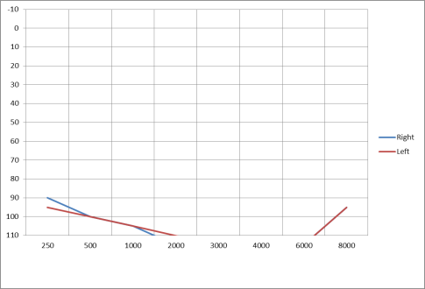
Lessons Learned
Correcting the diagnosis
Findings
35 y/o man with profound hearing loss and vision loss
Normal developmental motor milestones
Family history negative
Given diagnosis of USHER Syndrome Type 1
Notes:
Would delete this one. It’s the same story.

Slide 15
Lessons Learned
The diagnosis can be more complicated than expected
Diagnosis
Diagnosis NOT Usher Syndrome but NSHL and optic atrophy
  Hearing loss - DFNB4 caused by mutations in SLC26A4
  Retinopathy - OPA1-related optic atrophy
Findings
35 y/o man with profound hearing loss and vision loss
Normal developmental motor milestones
Family history negative
Given diagnosis of USHER Syndrome Type 1
Notes:
I’ll quickly show you scientific data that led us to a number of lessons learned – and I invite you to meet with me afterward to learn more.
Would just say what the lesson learned is.

Slide 16
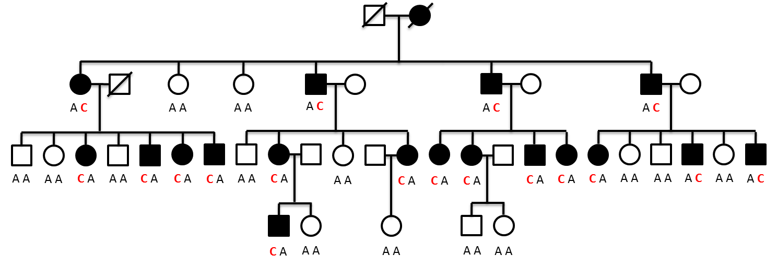
Lessons Learned
Genetic mutations can have a wide variety of effects
COL11A1: c.652-2 A>C
What we thought: Mutations in COL11A1 only cause Stickler & Marshall Syndromes
What we discovered: Mutations in COL11A1 also cause ADNSHL
Notes:
Again, just the lesson learned

Slide 17
Lessons Learned
Comprehensive genetic testing allows for phenotypic refinement
COL11A1: c.652-2 A>C
What we thought: Mutations in COL11A1 only cause Stickler & Marshall Syndromes
What we discovered: Mutations in COL11A1 also cause ADNSHL
Notes:
Again, the lesson learned

Slide 18
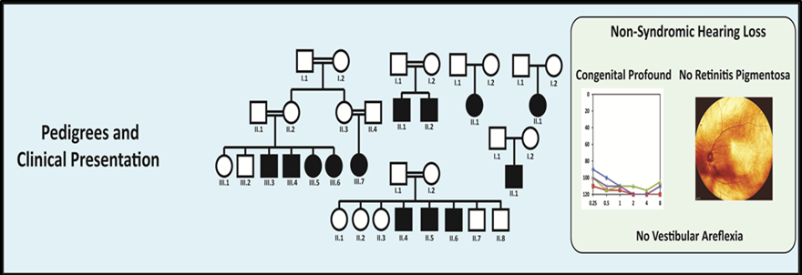
Lessons Learned
Comprehensive genetic testing allows for phenotypic refinement
Phenotypic refinement can make a huge difference in healthcare planning
What we thought: Mutations in CIB2 cause USH1J
What we discovered: Mutations in CIB2 cause ARNSHL and not USH1J
Notes:
Would say the lesson learned. The audience will be very interested in the “huge difference in healthcare planning.”
______ from my lab will be speaking later at the convention to talk about healthcare planning.

Slide 19
Conclusions
A large number of genes cause hearing loss
Notes:
Conclusion slides are fabulous. Nice!!

Slide 20

Conclusions
A large number of genes cause hearing loss
All genes can be tested for genetic variations simultaneously

Slide 21
Conclusions
A large number of genes cause hearing loss
All genes can be tested for genetic variations simultaneously
Detailed studies of many families are refining our understanding of hearing loss

Slide 22
Conclusions
A large number of genes cause hearing loss
All genes can be tested for genetic variations simultaneously
Detailed studies of many families are refining our understanding of hearing loss
New knowledge is improving hearing healthcare today and will be the foundation for the development of novel strategies to improve hearing health tomorrow

