Slide 1
Genetic Counseling for Hearing Loss
Emily Calamaro, MGC, CGC
University of Rochester Medical Center
Notes:
Intro – Certified GC currently working in the Division of Peds Genetics at URMC where I have been since 2016.
I will be giving examples and experiences from our general genetics clinic here at the University of Rochester, so please keep in mind that when visiting different clinics and providers, their process may look very different.

Slide 2
Outline
Who are genetic counselors?
Why should I see a genetic counselor?
What can I expect from a genetics appointment?
What about genetic testing?
What does this mean for my family members?

Slide 3
Genetic Counselors
Medical professionals with specialized training (Master’s degree) in genetics and counseling to help patients and their families understand and make decisions about their genetic health
Choose and interpret genetic tests
Use non-directive counseling
The goal of genetic counseling is to help the patient make the right decision for them
Support patients and families to:
Understand how genetic conditions may impact them
Understand genetic inheritance, risks, occurrence, recurrence
Make informed decisions about their medical care

Slide 4
Genetic Counselors
Most work in a clinic or hospital setting with various other specialists
Many work directly with a Medical Geneticist
Work in a variety of specialties:
Prenatal/Preconception
Pediatric
Cancer
Cardiology
Neurology
Research

Slide 5
Credentials: More like Alphabet Soup
Genetic counselors are board certified by the ABGC (American Board of Genetic Counseling)
CGC: Certified Genetic Counselor
Not always required
LCGC: Licensed Certified Genetic Counselor
Now required to practice genetic counseling in many states
Must be board certified to be licensed

Slide 6
Reasons for Referrals
Preconception/Prenatal
Parent’s personal history
Family history
Abnormal screening tests
Multiple miscarriages
Advanced Maternal Age (AMA)
Previous child with a birth defect or genetic condition
Infertility
Maternal conditions (diabetes, cardiomyopathies, etc.)
Pediatric
Birth defects
Autism spectrum disorders
Developmental delays
Intellectual disabilities
Dysmorphic facial features
Hearing loss
Seizures
Adult/Cancer
Family history of genetic disorder
Signs of progressive disease
Personal or family history of early-onset/rare cancer

Slide 7
What to expect
Appointment will last between 30-60 minutes
Interpreter present
Discuss the reason for referral
Thorough review of the patient’s birth, medical and family history with the GC
Discuss options for genetic testing
May include a physical exam by MD
Genetic test consent obtained
Genetic testing performed
GC reviews genetic test results thoroughly
Disclosure of test results and follow up recommendations
Further testing, specialist referrals, familial testing, etc.
Notes:
The GC has already reviewed the patient’s referral and medical history to the best of our abilities.

Slide 8
History Review
Prenatal and birth history
Maternal exposures to medications/drugs/alcohol
Maternal infections
Infections during newborn period
Medical History
Age of onset of hearing loss
Congenital, pre-lingual, post-lingual, late-onset
Type
Conductive vs. Sensorineural vs. Mixed
Severity
Mild, moderate, severe, profound
Other: Vision, kidney, heart problems, birth defects, etc

Slide 9
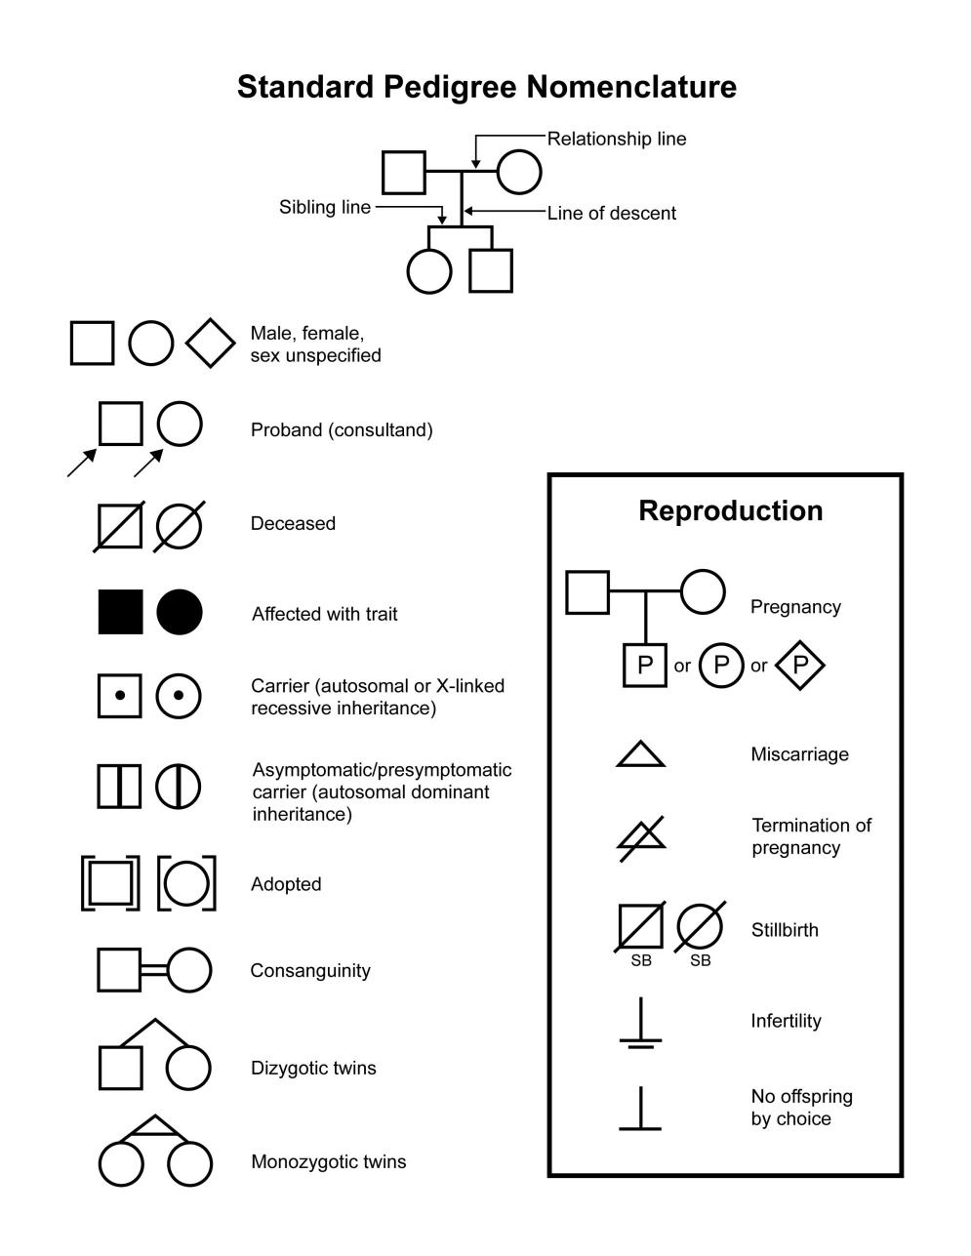
Family History
The genetic counselor will draw your pedigree, or family history
Uses standardized symbols
Easily shows relationships and medical information to reference later
Even if there is no family history of hearing loss, reviewing your pedigree is still important!

Slide 10
Family History
Who else in the family has hearing loss?
What is their relationship to the patient?
Has an underlying cause of their hearing loss been identified?
Has any genetic testing been done?
Review of specific test results is important to determining risks

Slide 11
What is a “Genetic Test”?
There isn’t just one “genetic test”
A common misconception in our patient population
Which test to order depends on the indication, history, and suspected cause
Genetic variant previously identified in the family?
Syndromic vs. Non-syndromic?
Not everyone should get the same test!
Can be done by blood or saliva sample depending on the test/lab specifications

Slide 12
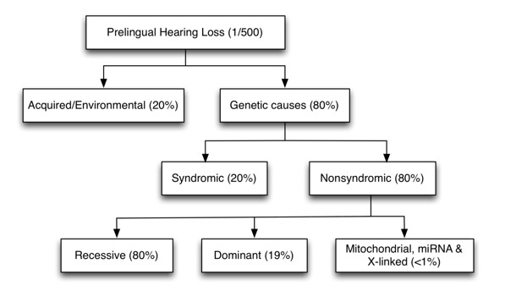
Genetic Testing for Hearing Loss

Slide 13
Types of Genetic Testing
Site-specific, familial variant testing
Indication: Previously identified variant in the family
Close degree of relationship
Single gene or small gene panel
Indication: Specific condition suspected or diagnosed clinically
Example: Usher syndrome
Large gene panel
Indications:
Multiple conditions possible and unable to narrow down list of genes based upon review of history
Second-tier testing, after prior testing has been negative
Example: Apparent non-syndromic, bilateral sensorineural hearing loss
Chromosome-based testing
Chromosome microarray, chromosome analysis, etc
Example: Child with hearing loss and multiple birth defects

Slide 14
Genetic Test Results
Positive – a gene/chromosome variant identified that explains the patient’s clinical symptoms
Negative – no gene/chromosome variants were identified
This does NOT necessarily mean there is no genetic cause or component
Variant of Uncertain Significance – a gene/chromosome variant was identified, but the clinical significance is unclear at this time
Follow up testing may be recommended
Research possibilities
It is common for a patient’s test to result in a combination of the above
Incidental findings
A test result indicates the patient has, will develop, or is likely to develop a condition or certain symptoms that are not currently present or suspected
These typically occur when doing larger panels or more broad-based testing (i.e. chromosome microarray)

Slide 15
My Test is Positive…Now What?
After disclosure of test results, the counselor will provide:
Thorough explanation of the condition based on our current understanding
Inheritance pattern
Anticipatory guidance
Is the hearing loss progressive?
Could there be additional symptoms?
We don’t have a crystal ball!!
Recommendations for follow up specialists/referrals as appropriate
Emotional support and resources
Support groups, online resources, contact with other patient’s and/or families
Recommendations for other family members

Slide 16
Familial Genetic Testing
It is always best to initiate testing with the individual who has hearing loss before testing other family members
Once a genetic variant has been identified, other family members can be tested
The genetic counselor will help to:
Identify which family members are at risk
Make a plan for how to discuss the results to family members
In order for family members to be tested, a copy of the test results should be provided
This tells us: What condition, which gene, the specific variant, which lab was used
Not all family members need to be tested!

Slide 17
Insurance Coverage
Insurance coverage is based upon medical necessity, which depends on specific plan/policy guidelines
We always try to obtain insurance prior authorization
Blood/saliva sample is not obtained until after PA approved
Insurance coverage can be a significant barrier to genetic testing for many people
Your genetic counselor can help determine the best course of action, and may be able to provide alternative payment option

Slide 18
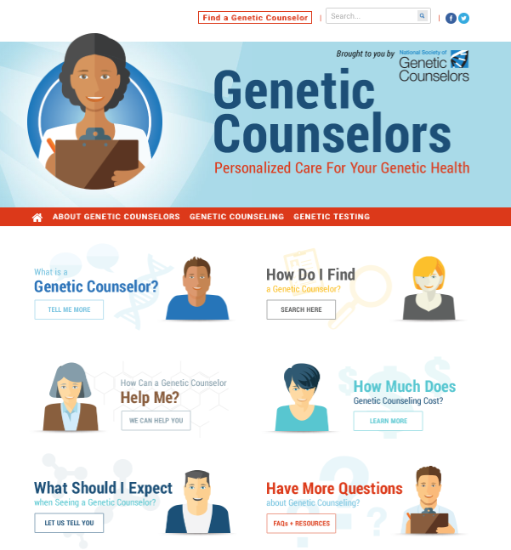
Want more information?
NSGC.org
aboutgeneticcounselors.com

Slide 19
Questions?

Slide 20
References
National Society of Genetic Counselors. Genetic Counselors. aboutgeneticcounselors.com
American Board of Genetic Counseling. abgc.net
Shearer, A.E., Hildebrand, M.S., Smith, R.JH. (2017). Hereditary Hearing Loss and Deafness Overview. GeneReviews. https://www.ncbi.nlm.nih.gov/books/NBK1434/

