Slide 1
Expanding our Reach: Building an Effective Professional Advisory Committee
Suzanne E. Johnston, VP, HLAA Rochester; Timothy Whitcher, HLAA Rochester
Notes:
Both former PAC members and chairs

Slide 2
What is a Professional Advisory Committee?
Group of community volunteers (or compensated individuals) from various industries
Provides support and/or advice to the host group
May help focus and develop ideas in areas of particular interest to the Chapter
May increase membership and interest in host organization
Meets regularly on a long-term basis
Relationship is symbiotic and synergistic
Notes:
SJ) Group of ppl who are gathered to provide advice and focus to the org.
SJ) Meets periodically - ours is 3x/yr + dinner. Busy professionals
SJ) Professionals also learn about the org and how to incorporate the ideals into their work envir.

Slide 3
The Role and Value of a Professional Advisory Committee
Leverage support and giving from a broad crossection of the community
Advise and respond to questions from the organization, provide perspective, and advocate for chapter interests in the community
Develop recognition and presence in various industries to create greater visibility of the organization’s mission
Develop positive and meaningful relationships with individuals who will ultimately lead to facilitation of the work of the organization
May increase giving and membership to chapter
Notes:
[tjw] When the PAC membership is diverse and it is proactively supporting the chapter’s mission, the chapter might experience increased support and giving.
[tjw] The network of the PAC members is now available to the chapter to leverage in their activities.
SJ) Works well when selection includes ppl from a broad crossection of industry, depending on areas the org wants to permeate
SJ) Relationships continue for years to come

Slide 4
Focus the work and goals of the organization
Provide fresh/creative and unique perspectives
Offers new information and education, resources
Provides a ‘feeder’ group for the Board and other chapter roles
Supports the work of the Board/organization
Provides a voice from the community
Offers diversity and energy to the Board and organizational members
Notes:
SJ) By calling specific industry experts, the org. is encouraged to reflect on how it may impact that industry
SJ) WE are an example of how PAC members can continue to benefit the organiz over the long term. May include BOD involvement, members of committees or task groups, etc.
SJ) PAC members DO the work of the org. in the community so that BOD doesn’t have to
SJ) Anytime the chapter is able to add an advocate and voice in the community, the effects of the organization is exponentially impacted
SJ) BOD can often be populated by retired, older, caucasian, middle/upper income indiv. A PAC provides opprotunity to seek diversity in age, race, culture and ideas. Can be a shot in the arm to org and provide new and exciting ideas and ventures

Slide 5
Attracting and Retaining Members of a Professional Advisory Committee – Developing a Vision
Study your chapter’s mission and goals - seek gaps and underserved industries
Be deliberate in planning for reaching out to various industries
Identify individuals who are recognized and respected in their industry
Be ready to describe the mission of your chapter and relate it to a particular advisor to be invited – focused expectations
Notes:
[tjw] To achieve this, it helps to have a written Mission statement so that potential PAC candidate members can be identified.
SJ) When selecting new potential members, constantly re-evaluate under-utilized industries and look for potential impact in the community
SJ) By selecting a visible member of the community, or one who is well-connected, the reach and potential of connection is amplified

Slide 6
Challenges
Chapter’s time and work involved in planning and organizing, creating connections and communications
Convincing otherwise busy professionals
Working to maintain interest and excitement of both Chapter and PAC members
Educating committee members and equipping them for work in the community for the interests of the organization
Allowing opportunities/adequate time for sharing of ideas
Maintaining relationships following tenure
Notes:
[tjw] Online collaboration tools such as Google and Slack facilitate communication among the PAC members and with the chapter members. This is beneficial as a written record of all communication transactions will be automatically generated.
SJ) PAC members are often busy professionals. Be definite about how to invite and attract with minimum of time commitment
SJ) Stay connected through email comm. and ensure that BOD also engages during meetings. Encourage discussion and be clear and planned in how to develop this during meetings and beyond Visit their place of work and treat them to lunch
SJ) Be sure PAC understands the org and mission, its structure and intent in inviting the PAC member to the org.
SJ) Building in ample time during meetings for open discussion and free exchange of ideas
SJ) Maintaining relat. following end of term can be just as valuable - sometimes more val. Think of opportunities to stay engaged beyond tenure
[tjw] It is important to know the PAC members interests so that the committees activities feed their interests.
[tjw] Additionally, the PAC members educate the chapter members in how to work with various community entities.

Slide 7
Choosing members of a Professional Advisory Committee
Following organizational By-Laws, Mission Statement
Importance of Selecting a Chairperson
Selecting an optimal number for the Committee - criteria
Terms of service
Securing nominations
Amount of work expected
Industries to be represented
Influence in the community
Alignment with the chapter’s goals
Nominees’ bio and selection by Board
Notes:
[tjw] A written procedure that outlines the the selection process for a PAC committee member should be developed by the chapter. The By-Laws and Mission Statement guide the selection process. This written procedure should be placed in a chapter archive for periodic reference.
[tjw] The chapter’s mission statement should define the key areas where PAC members can provide expertise.
[tjw] PAC members might be able to identify other potential PAC candidate members through their professional network.
SJ) Chair selection: MOST important - can make or break an effective committee Lookiing for specific qualities in a chair: social skills, leadership, motivation, consider amount of time available, their connection with the organization, organizational skills, sensitivity and ability to effectively run a meeting
SJ) Optimal number - balancing underwhelming and overwhelming. remember tht not all PAC membrs will show up each meeting. ensure that there is a cushion for absences or for those who may need to step down. If you have formal presentations, ensure that everyone gets an opp.
SJ) Terms of service - stagger terms so that not all are going off/coming on at the same time. 2 groups
SJ) Nominations: ask for input from BOD and other PAC members. look for community leaders and ‘buzz’ Leverage organiz. need with what member might have to offer. Trick is getting some level of commitment before a vote. Careful about having to turn anyone away once invited.
SJ) being clear about the scope of work and amount of commitment with potential nominees. Meet with PAC member/nominee, Provide information, over coffee. Don’t overwhelm.
SJ) inventory industries to be represented. not all can be represented at once, so be deliberate in selection and strategy
SJ) Discover what influence and impact that potential member might have in the community. How will they touch others in their industry and beyond?
SJ) Ensure that the potential PAC members are educated enough about the chapter mission/goals and organiz. structure so that they understand how to help accomplish chapter’s goals
SJ) Selection and bio. Look for diversity. Provided to the BOD as well the nominating committee. Is utilized to help the BOD understand the work and influence of the potential member. Bio should include contact info, personal as well as professional info. Bio/contact info is shared with the BOD. Process is for the nominating committee to choose and make recommendations of the slate to the BOD.

Slide 8
Chairperson’s role/duties
Convener and coordinator
Scheduling
Communications
Agendas/minutes
Meeting technical needs
Maintain records of members
Liaison to Chapter, Board of Directors
Recognitions
Notes:
[tjw] If collaboration tools are used the chairperson should ensure of their use and upkeeping. Update the chapter archive with the agendas, minutes, and actions.
[tjw] The chairperson will have to proactively solicit input and participation by members of the chapter and its BOD.
[tjw] Recogntion of the PAC members should me made by the chairperson. If the chapter has an annual banquet that is a potential venue.
SJ) Chair is primary person responsible for most things PAC related on a month-to-month basis. Best if member of the Board, if not then need a liaison to the BOD.
SJ) Scheduling and communications should be copied to the BOD to keep them in the loop. Communication technology which utilizes broad access is best for members from a variety of office systems.
SJ) Agenda is forwarded a week ahead of time. May include questions to respond to, or announcements for planned topics of disucssion
SJ) Minutes can be formal or just transcription of captioner, if available.
SJ) Teaching opp for optimal communication. Captioning and looping if available. May need a team of ppl to help set-up
SJ) Regular communication ensures that records and contacts are updated and all are on the same page

Slide 9
Professional Advisor’s roles
Receive and respond to communications
Familiarize with mission/work of organization
Engage in work of the organization as able/appropriate
Attend meetings
Communicate work and ideas to Committee, Chair
Disseminate and activate work/mission in the community as feasible
Notes:
[tjw] Communications might come from the chapter BOD, Board Liaison, chapter members or other PAC members.
SJ) Chair should provide information regarding organization, ByLaws, structure, committees, activities, and contact people. Complimentary membership to Chapter and National
[tjw] PAC members should use their professional experience to help scope and manage the chapter’s activities.
SJ) The PAC member should be able to describe how his/her knowledge is impacting what they are doing out in the world.
[tjw] Should a PAC member take on a leadership role in a chapter activity? Depends on …

Slide 10
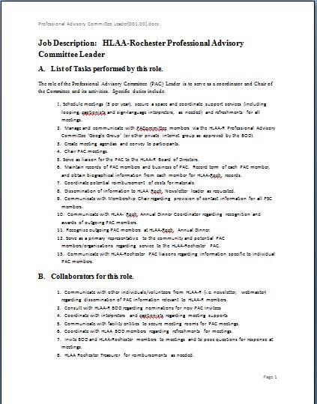
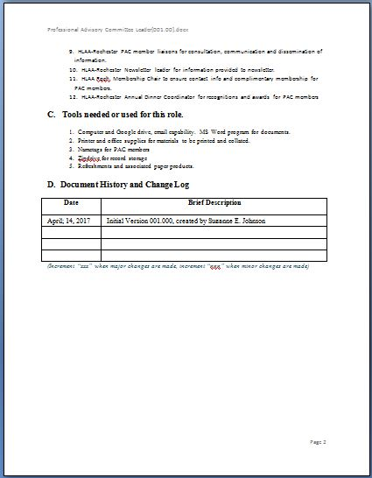

Slide 11
Running Professional Advisory Committee meetings
Board’s presence and familiarity with members
Preparing in advance for active discussion and flow
Frequency and timing of meetings
Length of meetings
Networking and socialization –getting to know you
Format of formal meeting time
Introductions and ‘catch-up’
Presentations
Discussion
Questions
Chapter news
Notes:
SJ) Important that BOD has understanding of the work and role of PAC members in the community so that they can leverage this info with mission/goals of the chapter
[tjw] It is important to manage meeting time so that most if not all agenda items are addressed to minimize unfinished business.
SJ) Provide questions or discussion information in advance of meetings
[tjw] The frequency and timing of meetings is important. Too many meeting detracts from attendance but too few breaks continuity and makes it difficult to perform any meaningful actions.
[tjw] It is important that the chairperson conveys a “sense of urgency” in the PAC meetings to keep them productive.
SJ) Timing of social vs formal meeting

Slide 12
Encouraging sharing and collaboration
Supplying members with questions or needs ahead of meeting times
BOD attendance
Prior to formal meeting times – networking/social time
During meetings – ensuring each member’s contributions
Contacts and follow-up in-between meetings
Staying connected through Chapter activities
Members are invited to assume other roles within Chapter
Notes:
[tjw] The chairperson and committee members should feel free to have direct communications with others.
SJ) Chair may choose to request questions prior to meetings to prepare PAC members for discussion. This provides for thoughtfulness from the BOD regarding information to glean from the expertise of its members
[tjw] The chair should provide advance copies of the agenda to the committee members and the chapter Board of Directors. Advance communication to a specific PAC committee member should take place if needed.
SJ) Board members are expected to attend as they are an integral piece of the equation.
SJ) Don’t minimize social time. Provide refreshments and introduce members to BOD and each other. Networking opportunities are an important element of PAC members’ participation as a busy professional This provides benefit to PAC members beyond their participation on the PAC This can be some of the most effective and important time of the meeting!
SJ) Liaisons should regularly be in touch with PAC members to ‘check in’ and ensure things are going smoothly. Can also be a good opp to learn from the PAC member about their needs and interests
[tjw] Time management helps ensure all members have their chance to contribute.
SJ) Let PAC know about chapter activities, and invite members to specific roles that may suit them esp.

Slide 13
Maintaining an effective Professional Advisory Group
Regular reflection and re-evaluation by BOD, Chair
Professionalism
Regular, complete and effective communication with members
Encouraging relationships/mentorship between committee members
Providing guidance and support
Provide a liaison from the Board of Directors.
Showing appreciation
Recognition of members’ value
Don’t overwhelm
Notes:
[tjw] Encourage volunteer activity by the PAC members in addition to chapter issues.
[tjw] The chairperson should keep all PAC members involved and not be afraid to ask for the completion of action items by a PAC member as some PAC members might be unsure of how involved they should be GOOD POINT. Any assigned actions should be in the PAC members interest and expertise.
SJ) New PAC members can learn from more seasoned members.
SJ) A liaison can be a valuable connection from the Board for the PAC member. Personal contact and sounding-board, resource.
SJ) Annual dinner recognitions. Deliberate recognition and celebration of accomplishments

Slide 14
Comments from guest Professional Advisory Committee member:
Ralph Meranto, Artistic Director, Jewish Community Center

Slide 15
Questions and Comments????

Slide 16
BIBLIOGRAPHY
Biggerstaff, P., Addressing the Challenges of Growing an Effective Advisory Committee., The CTE Journal, Vol. 4:2
Davidson-Goldbronn, Candie Senior Director. "How to Engage and Manage Your Nonprofit Advisory Council." BLOG, CCS Fundraising, July 15, 2014
Latta, Marcia S., Creating an Effective and Meaningful Advisory Board., Journal of Education Advancement and Marketing, Volume 1/ Number 4/ Spring 2017.
Mariama-Arthur, Karima, Esq. "Why Selecting the 'Right' Advisory Board Members Should Matter to Your Organization.", Forbes Coaches Council, Forbes, December 11, 2017.
Reiter, B., The Role and Value of an Effective Advisory Board., Ivey Business Journal, Sept/Oct 2003.

