Slide 1

Cochlear Implant Timing: Why waiting may not be a good idea (once you’re a candidate)

Slide 2
Speaker Details
Donna L. Sorkin MA, Executive Director
American Cochlear Implant Alliance
Formerly: Executive Director of HLAA (1993-1999)
www.ACIAlliance.org
dsorkin@acialliance.org

Slide 3

Why another organization in hearing health?
Membership organization focused on cochlear implantation & access to care
Members: audiologists, physicians, speech pathologists, educators and others on CI teams + consumers/parents, advocates
Website designed for those in and out of CI
Highly collaborative with other organizations including HLAA
Serve on a number of coalitions with HLAA
Welcome your involvement!
www.acialliance.org
https://www.facebook.com/ACIALLIANCE.ORG/
Twitter@acialliance

Slide 4
American Cochlear Implant Alliance
Mission: Advance access to the gift of hearing provided by cochlear implantation through research, advocacy and awareness
Address factors contributing to underutilization of cochlear implants
Improve awareness regarding candidacy and outcomes
Objective today: Share information to help people who may benefit from CI move forward

Slide 5
AGENDA
Where are we or where were with the cochlear implant process?
Cochlear implants have evolved/candidacy has expanded
Adult and parent perspectives on cochlear implants
Evidence/research on CI and outcomes
10 Reasons Not to Wait
Health implications for adults including dementia, reduced risk of falls, ability to carry out activities of living
Quality of life impacts

Slide 6



Utilization of CI in the U.S.
Data Sources
¹NIDCD, NIH, https://www.nidcd.nih.gov/health/statistics/quick-statistics-hearing
~38 million with HL¹
² iData Research 2010 Report US Market for Hearing Aids and Audiology Devices in 2009 there were approximately 1.2M patients who could benefit from a CI
Potential implant
candidates²
1.2 million
severe to profound
³ 96K, (58k adults and 38k children) have received CIs in the U.S, as of Dec 2012. NIDCD website: https://www.nidcd.nih.gov/health/cochlear-implants.
~100k received CI³
~8.3% penetrated
Notes:
American Academy of Audiology https://www.audiology.org/news/incidence-severe-and-profound-hearing-loss-united-states-and-united-kingdom

Slide 7
What do you think accounts for the low utilization of cochlear implants?
Lack of awareness/understanding of candidacy and outcomes
Most insurance policies don’t cover CI
There are better options for severe to profound hearing loss that don’t involve surgery (such as high tech hearing aids and remote microphones)
Other hearing restoration options are expected to be available to adults soon

Slide 8
What do you think accounts for the low utilization of cochlear implants?
Lack of awareness/understanding of candidacy and outcomes
Most insurance policies don’t cover CI
There are better options for severe to profound hearing loss that don’t involve surgery (such as high tech hearing aids and remote microphones)
Other hearing restoration options are expected to be available to adults soon

Slide 9

Raise Your Hands
How many people have a cochlear implant(s)?
  How long did you wait once you knew you were a candidate?
  If you had it to do over, would you have waited so long?
How many people think that they or a relative/friend would benefit from a CI?
  Are you/they waiting to move forward?
  If waiting, why?

Slide 10

Who is a candidate?
Audiologist polled hearing aid centers and found:
  Dispensers do not clearly understand newest candidacy criteria
  Confused on who to refer and when
  Not necessarily worried about losing a patient if person could benefit

Slide 11
  Candidacy has evolved
  More residual hearing
  Shorter duration of deafness
  Younger age at implantation (but we also implant plenty of people in their 90s)

Slide 12


Expanded Criteria for Cochlear Implants
Acoustic and Electric (A+E) hearing in same ear
  Typically a contralateral hearing aid
  Accomplished using
    Hearing preservation electrode
      Shorter in length
      Indicated by FDA as a hearing preservation electrode
    Standard length electrode
Bimodal hearing: acoustic and electrical hearing in opposite ears
A+E
Bimodal

Slide 13

Top Reasons Most Adults Don’t Pursue a Cochlear Implant (when they could)
Don’t know much about cochlear implants
“I’m not deaf” (or not deaf enough) ➔ candidacy
Don’t how much they would benefit
They think they’re too old (Q: How old is too old?)

Slide 14

I’m doing ok and …
I don’t want to lose the residual hearing I have
I’m doing ok (with hearing aids, an FM system, a hearing dog, captioning, sign language, telecommunication relay services)
I’m afraid of surgery (I’ve been told this is brain surgery)
Cochlear implants are expensive—even more so than hearing aids
I’ve heard some culturally Deaf people say they don’t work
I’ve heard music doesn’t sound the same
I don’t like the way they look

Slide 15

I’m waiting
For CI technology to improve
For hair cell regeneration (Personally, I’ve been waiting 25 years)
For a better option (i.e., light based stimulation, gene therapy)
Until I get less (or no) benefit from hearing aids
Until I am completely deaf

Slide 16
10 Reasons Not to Wait

Slide 17
Key (Non-)Reasons for Waiting
Even more expensive than hearing aids: Covered by health insurance (Medicare, Medicaid, VA, 90% of private policies)
Don’t want to lose the hearing I have: Residual hearing no longer totally destroyed and recipients gain more than they lose
Waiting for better technology: Outcomes are excellent now and recipients continue to benefit from advances in external sound processors + waiting not a good idea
I’m doing ok: But it exhausting to depend upon all of these accommodations and still not really hear

Slide 18
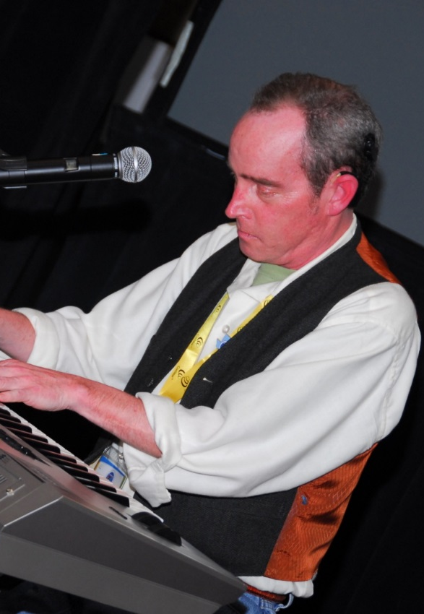
More Reasons Not to Wait
5. Undertreated hearing loss has health risk factors: Associated with higher rates of dementia, greater risk of falls, unemployment, longer hospital stays
6. Not waiting=better CI outcomes: Research shows that people with more residual hearing and shorter duration of deafness do better
7. Outcomes are better than ever and keep improving: processor upgrades mean access to the latest technology
8. Hair cell regeneration/other approaches not ready: may never be a solution for adults with significant hearing loss
9. Most people do enjoy music though it may sound different (Richard Reed: ”Music lost and found”

Slide 19

10. Quality of life benefits beyond better hearing. Why not start enjoying the benefits of better hearing (for yourself and your family/friends) as soon as you are eligible?

Slide 20
A Few References
www.acialliance.org (insurance, outcomes, age, QoL)
Better outcomes for shorter duration deafness: H. Kim, Nature 2018. Cochlear Implantation in Postlingually Deaf Adults is Time-sensitive
Dementia/other health issues. Gurgel, Relationship of Hearing loss and Dementia Otol & Neuro 2014.
Hearing preservation with CI: large body of research
Quality of Life. ACI Alliance sponsored research by T. McRackan. ACI Alliance website under Research

