Slide 1
ABCs Of Living Well With Hearing Loss
Samuel Trychin, PH.D.

Slide 2
            Two Basic Requirements For Living Well
1. Avoid or escape from harmful or distressing things or events—those that threaten physical and psychological health and integrity,
2. Approach and acquire beneficial or pleasant things or events—those that promote physical and psychological health and integrity.

Slide 3
What We Need in Order to Survive Well
1. Ability to detect those harmful and beneficial things and events.
2. Ability to learn ways to avoid or approach those harmful and beneficial things and events.
3. Ability to consolidate that learning in memory for dealing with future similar things and events.
4. Ability to establish beneficial habits and avoid harmful habits. e.g.

Slide 4
Beneficial and Harmful Habits
1. What are some beneficial habits for people who have hearing loss (PHL)?
2. What are some beneficial habits for their communication partners (CPs)?
3. What are some harmful habits for people who have hearing loss (PHL)?
4. What are some harmful habits for their communication partners (CPs)?

Slide 5
Effects of Hearing Loss
Hearing loss, one of our most basic and important senses, affects two levels of human functioning:
1. External, physical and social , and
2. Internal, physiological, emotional, and cognitive.
3. The interactions between 1 and 2 are critical.

Slide 6
Hearing Loss and The Physical Environment
The external environmental system—hearing loss affects a person’s ability to detect important environmental sounds:
Such as?......
Katrina, car horns, alarms clock, sirens, telephone ringing, kettle whistling, microwave timer, growling dog, etc.
Question: What is the influence of one’s sense of control or influence over events on feeling competent, comfortable?

Slide 7
Hearing Loss and The Social Environment
Hearing loss is primarily a communication disorder for most people who experience it.
As a communication disorder, hearing loss affects:
The person with hearing loss who is listening, and
The person who is speaking to him/her-the communication partner.
Good perspective for PHLs & CPs: “It is our hearing loss.”

Slide 8
Hearing Loss and the Physical, Emotional, and Cognitive Systems
The internal, physiological systems, such as, the nervous, hormonal, cardiovascular, respiratory, immune, and digestive systems.
Two internal system issues to consider are:
a. Emotional arousal, and
b. Thoughts, attitudes, and expectations

Slide 9
How might negative emotions (e.g., anger, anxiety, depression) influence one’s ability to:
1. Understand (and correctly interpret), what is being said?
2. Transmit information in a way that can be readily understood and accepted?

Slide 10
An interaction Between the External and Internal Systems Occurs, For Example, When…
Difficulty understanding discussion at a business meeting (external) produces…
Anxiety (internal emotional) lessens the ability to focus attention and use judgment (internal cognitive) which causes…
Increased inability to understand what others are saying (external) which increases anxiety(internal) further and also…
Prevents effective problem-solving (internal cognitive) and then
Communication problem persists/worsens(external).

Slide 11
In order to break these cycles people need to:
1. Manage communication situations, and
2. Manage themselves.

Slide 12
What do we need to do to manage communication situations in order to prevent or reduce communication difficulties?
1. PHLs
2. CPs

Slide 13
1. Managing communication situations involves:
Recognizing situations that produce problems and those that don’t,
Knowing the causes of communication breakdowns:
Knowing what to do to prevent/reduce communication problems.
Practicing until new behaviors becomes habitual.
Anticipating difficulties in upcoming events.

Slide 14
Knowing the problems face by (PHL), for Example:
Hearing alarm signals, at home/in a car
Someone talking to you from another room
Can’t see speaker’s face
Poor illumination
People whispering
Voice’s on TV or radio
Conversations in a moving car
Family dinners at holidays

Slide 15
Knowing the problems face by CPs, for Example:
Having to repeat often
Having to interpret frequently
When we become frustrated or irritated
When she/he doesn’t pay attention
Not talking as much as before
When he/she is not understanding someone else
Difficulty remembering what to do
Not knowing whether she/he understands

Slide 16
2. What do we need to do to manage ourselves?
PHL…?
CP…?

Slide 17
Managing Oneself Involves:
Recognizing internal (cognitive, emotional, physical) signs of distress.
Knowing the causes of the distress.
Knowing what to do to relieve the distress.
Practicing until new reactions becomes habitual.
Anticipating difficulties in upcoming events and practicing beforehand and during..

Slide 18
Several reasons for addressing emotional reactions related to hearing loss:
1. Can interfere with taking appropriate action to deal with a problem.
2. Can happen so often they become automatic reactions.
3. Can feel like a normal, justified reaction to a situation.
4. Person doesn’t know what to do to prevent/reduce difficult situations-feels stuck!
5.Doesn’t recognize/understand the relationship between specific situations, emotional responses, and their effects.

Slide 19
Frequent Causes of Communication Breakdowns
1. The Speaker, such as….?
2. The Environment, such as….?
3. The Listener, such as….?

Slide 20
Speaker Factors that Influence Understanding
Does not first get the listener’s attention
Does not face the listener while talking
Covers face while talking
Talks too rapidly/too slowly
Talks too softly/too loudly
Does not enunciate clearly
Uses too little/too much facial expression or body language

Slide 21
Environmental Factors that Influence Understanding
Background noise
Poor lighting
Poor room acoustics
Too far from source of sound
Visual or auditory distractions
Objects interfere with seeing speaker
Lack of alerting systems
Lack of visual aids-overheads, CART, etc.

Slide 22
Listener Factors that Influence Understanding
Severity of hearing loss
Type of hearing loss
Use of hearing aids
Use of assistive listening devices
Attention level
Emotional status
Distracting thoughts
Fatigue level
Motivation to hear

Slide 23
    So, What Can We Do to Prevent/Reduce Communication Problems?
PHL….?
CP….?

Slide 24
Listener (PHL) Guidelines
Practice relaxation skills beforehand
Pick the best spot to communicate
Anticipate difficult situations-plan ahead
Inform others how best to talk to you
Pay attention to the speaker
Look for visual cues of what is said

Slide 25
Listener (PHL) Guidelines
Do not bluff
Pay attention to the speaker
Inform the speaker about what you heard
Reinforce speaker’s helpful communication
Set realistic goals for understanding
Ask for key words in writing if needed
Arrange for breaks if meetings are long

Slide 26
Communication Partner (CP) Guidelines
Practice relaxation skills beforehand
Pick the best spot to communicate
Get the listener’s attention before talking
Be sure your face can be clearly seen
Do not have objects in your mouth
Speak slowly and clearly
Rephrase if you are not understood

Slide 27
Communication Partner (CP) Guidelines
Inform listener when changing subject
Don’t shout
Try to be patient, calm, and relaxed
Speak to, not about, the person who is HOH
Use facial expressions and gestures
Ask for tips to improve communication

Slide 28
Other effective communication behaviors (PHL)
Inform others about your hearing loss
Inform them about what to do
Remind them when they forget
Model the communication behavior you want from them
Reinforce other’s communication efforts
Relax and maintain your composure

Slide 29
Managing Negative Emotional Arousal
The Five F’s
1. Freeze
2. Flee
3. Fight
4. Faint.......or
5. Fix

Slide 30
High and/or chronic levels of emotional arousal:
1. Interferes with cognitive processing—can’t think straight.
2. Quickly depletes energy, making coping efforts difficult.
3. Often leads to inappropriate social engagement.

Slide 31
Remedies for Stress Reactions
Mindfulness: Being aware of one’s thoughts as they occur without judgment.
Muscle Relaxation
Breath Control

Slide 32
Several reasons for addressing emotional reactions related to hearing loss:
1. Can interfere with taking appropriate action to deal with a problem.
2. Can happen so often they become automatic reactions.
3. Can feel like a normal, justified reaction to a situation.
4. Person doesn’t know what to do to prevent/reduce difficult situations-feels stuck!
5.Doesn’t recognize/understand the relationship between specific situations, emotional responses, and their effects.

Slide 33
Questions for you:
1. Have you had a negative emotional reaction (anxiety/fear, irritation/anger, embarrassment/shame, or guilt) to something that happened or was said recently?
Try to re-experience that feeling now.
2. How did you know you were having that emotional
response?

Slide 34
When you experienced that emotion that came to mind, what did you do?
Five F’s
Freeze
Flee
Fight
Faint
Fix

Slide 35
Five F’s related to hearing loss:
Freeze--Bluff
Flee—Leave (physically or change subject),
Fight—Argue, criticize, demand
Faint—space out (withdraw psychologically)
Fix—repair the problem/situation

Slide 36
Many people who have hearing loss report experiencing distress when they fail to understand what someone is saying.
Communication partners also report experiencing distress when they are not being understood or are aware that their partner is not understanding someone else.

Slide 37
Hearing loss and emotion examples:
Dancing and talking-embarrassment/shame
Ghost Ranch couple-anger/resentment
Ghost Ranch grandpa-anxiety
PA Executive-guilt
White House-fear
Minister’s wife-anxiety
Dinner guest-anxiety/shame

Slide 38
To reduce distress we need to:
1. Manage communication situations in order to prevent or reduce those communication difficulties that are due to hearing loss.
Failure to do so can result in feeling:
Less acceptable to others,
Less competent in work and everyday functioning,
Less influence or control over social and other events.

Slide 39
We also need to:
2. Manage ourselves: Even when we learn and regularly practice tactics and strategies for preventing or reducing communication breakdowns, we will not always be successful because:
a. Other people can’t, or refuse to, cooperate, and/or
b. It is not possible to modify the environment

Slide 40
Emotions and Hearing loss additional factors:
Listening effort—hearing aids don’t help
Aging brain: loses top-down—uses bottom-up processing.

Slide 41
Survival functions of emotions:
Emotions lead us to avoid or escape from those thing in the environment that are dangerous or threatening.
Emotions lead us to locate and acquire those things in the environment that are beneficial for survival.

Slide 42
Emotions serve a social function by letting others know what we like and don’t like.
We transmit emotions by:
Words we say
Tone of voice
Rhythm of speech
Facial expression (40 of the facial muscles)
Body language
Mirror neurons
Electro-magnetic energy

Slide 43
Basis of Positive/Negative emotions and DHEA/Cortisol
Emotional ups and downs within certain limits are a necessary part of our everyday, normal experiences and provide and enhance the quality of our lives.
We need a certain amount of anxiety to do the more difficult things we need to do.

Slide 45
Shifting baselines
100% Maximum level of anxiety he has ever experienced
75% Sometimes he experiences this level of anxiety
50% Level of anxiety he often experiences
25% His current perception of baseline level (no anxiety)
0% His previous baseline level (no anxiety)

Slide 46
Threat pattern
The stress response involves two major pathways:
1.The neuroendocrine HPA axis, and
2. The autonomic NS
The threat pattern is a cardiovascular response to this activation comprised of:
1. Increased heart rate, and
2. Peripheral vasoconstriction

Slide 48
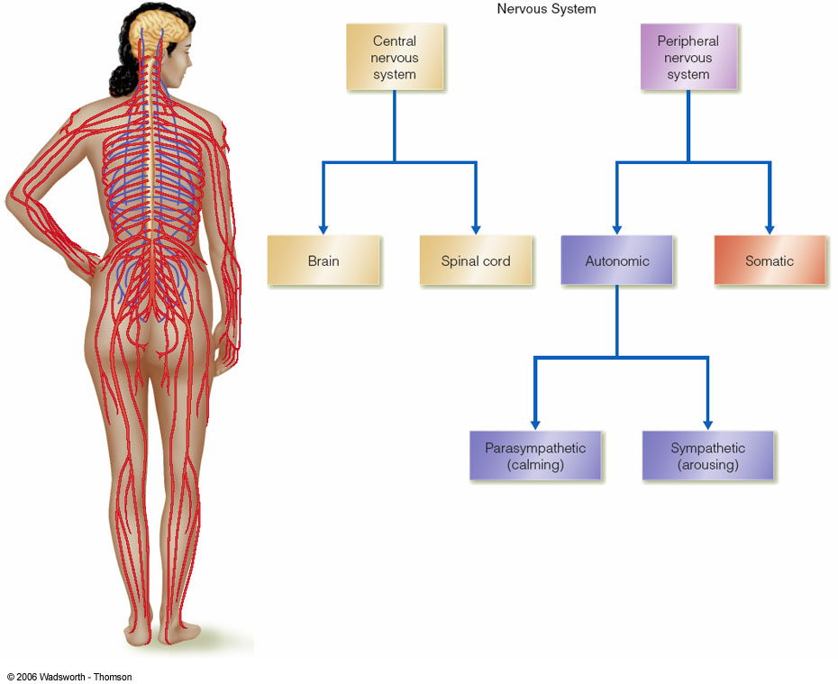

Slide 51
Parasympathetic (inhibitory) activity
The fastest way to activate the stress response, e.g., increase heart rate, etc. is to remove the brake by inhibiting vagal activation—occurs in milliseconds.
Sympathetic activation occurs in seconds.
HPA axis activation occurs in minutes.

Slide 52
…
When emotions run high and/or are chronically activated, they reactively produce behavior before we have opportunity to think about and evaluate the situation to determine the best course of action.
Then, we may find ourselves thinking, “I wish I hadn’t said that.” or “I wish I hadn’t done that.”
We also may be unable to access and use the techniques we know to be helpful for us.

Slide 53
…
Emotions are aroused by:
1. Current events—What is happening now.
2. Past events—Memories of what happened before.
3. Future events—Anticipation of an upcoming event.

Slide 54
Young gnu/deer captured by lioness video

Slide 55
What kinds of situations generally arouse negative emotions in you?
Anger?
Fear/anxiety?
Embarrassment/shame?
Sadness/depression?

Slide 56
:
Remember that behavior is a function of:
Thoughts—evaluations, judgments concerning what is happening, what happened, what might happen, what to do.
and
Emotions—feelings that motivate taking the action.

Slide 57
E-motions-this spelling helps in remembering that emotions move us, that is, produce movement in:
1. Internal, physiological processes, and
2. External, muscle movements that produce our interactions with the physical and social environments.

Slide 58
Important emotional dimensions:
How much (intensity)
How long (duration)
How often (frequency)

Slide 59
Fast track and Slow track responding and Habits:
Fast track--Sensation> central relay station > emotional center> muscle activation & hormones > verbal/physical behavior.
Slow track-Sensation> central relay station > decision/judgment center & emotional center > muscle activation & hormones > verbal/physical behavior

Slide 60
Two types of emotional memories
1. Explicit memories—those you are consciously aware of and can describe in words and/or that produce mental images.
2. Implicit memories—unconscious memories that operate below the level of awareness, but produce emotional reactions the source of which is difficult or impossible to determine.

Slide 61
Left hemispheric functions: cognitive analysis linear thinking, & language reception/production.
Right hemisphere: perception and expression of emotion, particularly negative emotions, and is
Involved in evaluating the emotional significance of incoming information and in regulating the autonomic and hormonal responses and to these incoming stimuli.

Slide 62
The right hemisphere is able to maintain a social/emotional system that can independently recall and act upon certain memories and perceptions without active participation from the left hemisphere.
It mediates sub- or un-conscious processes.
Focus is on the here and now.

Slide 63
The right hemisphere is able to maintain a social/emotional system that can independently recall and act upon certain memories and perceptions without active participation from the left hemisphere.
It mediates sub- or un-conscious processes.
Focus is on the here and now.

Slide 64
We need to learn to do what is necessary to better manage emotional arousal.

Slide 65
Procedures for managing emotions:
Skin temperature
Deep muscle relaxation
Autogenics
Deep, slow breathing
Heartmath Cut-Through procedure
Mindfulness, Yoga, Tai-Chi

Slide 66
Heart’s role
The heart transmits complex patterns of neurological, hormonal, pressure, and electromagnetic information to the brain.
For example, a recent discovery indicates that the psychological components of panic disorder is often created by unrecognized heart arhythmias.
Research indicates that patterns of afferent information from the cardiovascular system significantly influence emotional experience.

Slide 67
Heart’s role
Changes in the heart’s rhythmic activity can be intentionally generated in order to self-induce a positive shift in a person’s emotional experience.
This occurs via a change in the cardiac afferent signals sent to the brain, resulting in short and long-term beneficial emotional and physiological results.

Slide 68
Heart’s role
Repeated, intentionally self-generated, psycho-physiological coherence patterns result in changes in the neural architecture, resulting in establishing new baseline levels of emotional reactivity.
This is accomplished through the practice of emotional restructuring techniques.

Slide 69
Heart-brain interactions
With each beat, the heart transmits dynamic patterns of neurological (electrical), hormonal (chemical), pressure (pulse-wave), and electromagnetic information to the brain.
This information influences brain centers involved in perceptual, cognitive, and emotional processing and can either facilitate or inhibit cognitive functions.

Slide 70
Coherence and Breathing
Breathing slowly at a 5 second inhale and 5 second exhale pace can induce coherence heart rhythms and be emotionally calming, but it is difficult to maintain and requires considerable mental effort.
Heartmath techniques incorporate a breathing element, but it is not the primary focus, which is the intentional generation of a heartfelt positive emotional state.

Slide 71
Coherence and Breathing
Achieving the positive emotional status naturally aligns the breathing pattern without conscious mental effort.
Also, the positive emotional focus has additional benefits than those achieved via breathing:
1. Deeper perceptual/emotional changes,
2. Increased access to intuition/creativity,
3. Improved cognitive/performance, and
4. Favorable changes in hormonal balance.

Slide 72
Heartmath interventions
HeartMath interventions facilitate improved coherence through emotional refocusing and restructuring.
Changing negative, maladaptive emotional state to one of appreciation, care, concern, or other positive emotions is the path to establishing coherent heart rhythms.

Slide 73
Cut through technique:
1. Heart focus. Shift your attention to the area of the heart and breathe slowly and deeply.
2. Heart-focused breathing. Keep your focus in the heart by gently breathing— five seconds in and five seconds out—through your heart. Do this two or three times.
3. Heart feeling. Activate and sustain a genuine feeling of appreciation or care for someone or something
in your life. Focus on the good heart feeling as you continue to breathe through the area of your heart.

Slide 74
OK, let’s practice for three minutes.
1. Heart focus. Shift your attention to the area of the heart and breathe slowly and deeply.

Slide 75
2. Heart-focused breathing. Keep your focus in the heart by gently breathing— five seconds in and five seconds out—through your heart.

Slide 76
3. Heart feeling. Activate and sustain a genuine feeling of appreciation or care for someone or something in your life. Focus on the good heart feeling as you continue to breathe through the area of your heart.
Do this procedure for two minutes.

Slide 77
So, why not learn and practice procedures for establishing emotional control?
The Line—Importance to you? Motivation/Willingness? Self efficacy/can you do it? Acceptability
The Box—Status Quo vs. Change & Costs and Benefits

Slide 78
Three corrections in new book:
1. Page 5, line 16 should read: “…mouth, nose, and skin.” Then, delete: “that transmit the information to our brain from the spinal cord” Replace with “The brain and spinal cord together are known as the central nervous system (CNS).
2. Page 37, line 20 delete the word are following the word messages.
3. Page 41, last line delete the last sentence beginning with inexpensive hand held, etc.

